Slide 1
LEAD Civic Forum
Leaders in Economic Alliance Development
City│Date│Location
Add local sponsors/logos here
National Partners:
Notes:
Instructions: Insert the details into the slides including the addition of local sponsor logos as you see fit.
Have this slide up when participants enter the room. As you begin the session, acknowledge the sponsors/partners.
Time: 1 minute
Materials: none

Slide 2
What is LEAD?
Leaders – Focuses on building and strengthening leadership skills in the community
Economic – Concentrates on opportunities to enhance the local economy
Alliance – Fosters the development of new partnerships within the community
Development – Gets things done!
Notes:
Instructions:
Briefly explain the purpose of LEAD
Ultimately, LEAD is an opportunity for the community to bring together a larger set of partners to focus on 1-3 opportunities for action that can serve to strengthen the community/region for future economic growth.
Explain to participants that their role today will be key in helping to identify the opportunities that will be carried forward by the LEAD initiative, and that they will have the opportunity to join the work as it moves forward.
Time: 5 minutes
Materials: None

Slide 3
Sample Agenda & Lunch
9:30 AM Welcome/Introductions/Logistics
9:50 Round 1: Strengths
10:10 Round 2: Challenges & Report Out
10:40 Walking Break & Table Rotation
11:00 Round 3: Opportunities
11:30 Groups Report Out
11:45 Prioritize Topics & Lunch
Self Select into Opportunity Groups
Overview of Federal Agency Resources:
USDA RD, FSA, NRCS
Notes:
Instructions: The agenda on this slide and the next are samples only. Be sure to adjust the times to fit your community’s forum.
Briefly go over the agenda so that participants get a sense of what to expect from the forum. Explain that the process is interactive and encourage each person to share their thoughts as the day progresses. You may also wish to explain that the times are tentative as every group works at a different rate. You may even wish to take times off and just list the topics. Either way, having a printed agenda is not recommended as people may feel too tied to the clock.
Time: 5 minutes
Materials: None.

Slide 4
Sample Agenda, cont.
1:00 PM Opportunities to Action
What would success look like?
1:20 Opportunities to Action
In order to be successful, what do we need to do?
1:50 Opportunities to Action
What resources will help us reach success?
2:10 Groups Report Out
2:25 Next Steps
2:45 Concluding Remarks
3:00 Adjourn
Notes:
Instructions: Again, feel free to adjust this to your own community’s schedule. This text just provides a template for your use.
Time: 1 minutes
Materials: None

Slide 5
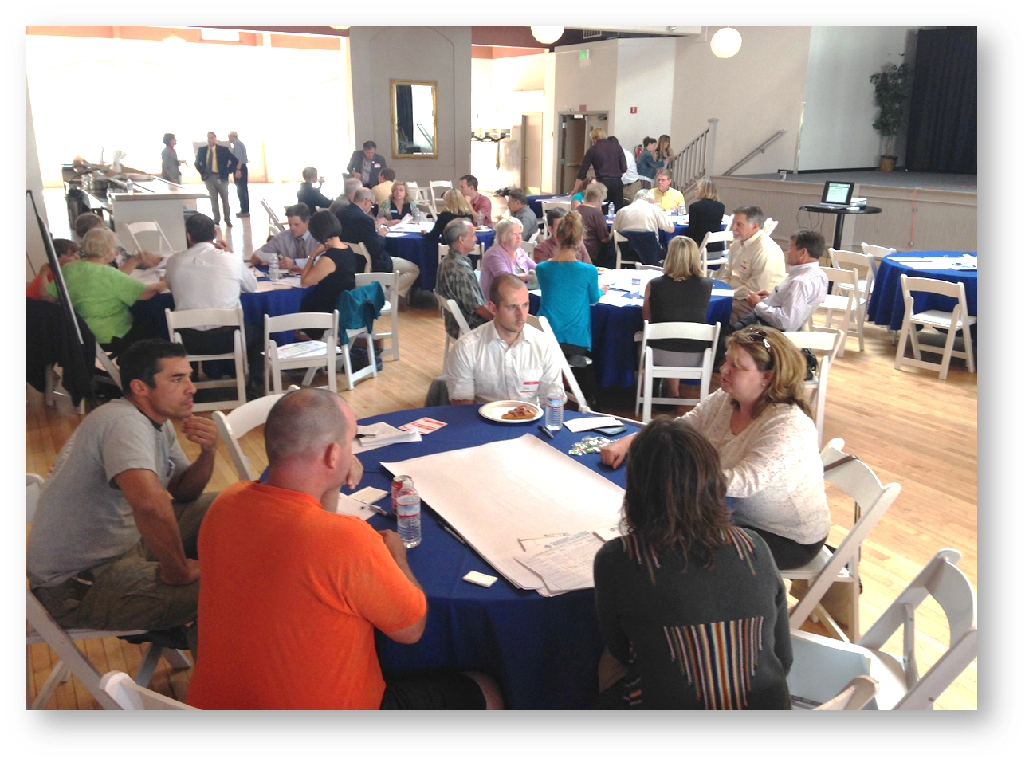
Ingredients for a Successful Forum
Share your honest views.
Listen carefully and respectfully to the views of others.
Only one person speaks at a time.
Speak from your own personal perspectives or experiences rather than on behalf of others.
Be sure everyone at the table shares talking time equally.
Turn off or silence your cell phones.
Notes:
Instructions: Use these guidelines to set the tone for the sessions. This may be a good time to ask table facilitators to raise their hands so each table knows who will be guiding that table’s conversation. Ask each person to help the facilitator maintain these guidelines.
Time: 2 minutes
Materials: Successful Forum guidelines cards for tables.

Slide 6
Round 1: Strengths
What do you think are your community’s greatest strengths?
Put a by the THREE things that your group sees as the most positive features (strengths) of your community.
Notes:
Instructions:
Thinking about the community, ask participants to brainstorm a list of the community’s greatest strengths.
Facilitators will list the items on a flip chart at each table. Allow about 10-15 minutes for the brainstorming.
Next, ask each table to identify their top three features and place a star beside each one. Allow 5-10 minutes for identification of these items.
Remind facilitators to put their table number on the chart page.
Do not do a report out at this time. Rather you will take these up and have a small team synthesize them while the participants continue with the next round. This should be done quietly in the background while tables continue to work on Round Two. The summary should include a listing of the top 3 features ranked in order by the number of tables that identified it as a top 3 feature.
Time: 30 minutes
Materials: Flipchart and markers for each table.

Slide 7
Round 2: Challenges
What do you think are your community’s greatest challenges?
Put a by the THREE things that your group sees as the biggest challenges.
Notes:
Instructions:
Thinking about the community, ask participants to brainstorm a list of the community’s challenges or barriers.
Facilitators will list the items on a flip chart at each table. Allow about 10-15 minutes for the brainstorming.
Next, ask each table to identify their top three biggest challenges and place a star beside each one. Allow 5-10 minutes for identification of these items.
Remind facilitators to put their table number on the chart page.
Time: 25 minutes
Materials: Flipchart and markers for each table.

Slide 8
Groups Report Out
Table facilitator: please share one challenge per table being careful not to duplicate items.
Notes:
Instructions: Ask each table facilitator to name one challenge from the table’s top three list, being careful not to repeat what has already been said. The forum leader should record these onto a master list. Once each table has had the chance to name one challenge, go around again to see if there are other “top 3” challenges that have not been named. If all three of a table’s selections have already been named, the facilitator can just pass. Continue with a third round if needed to get all tables’ top 3 challenges identified.
Then quickly go down the list calling out each item as you go and asking each facilitator to raise their hand if the topic was among their table’s top three. This provides a quick sense of how many tables identified the concern as a top challenge.
Time: 5 minutes
Materials: Flip chart and markers

Slide 9
Table Rotation
Notes:
Instructions: Explain that for the next round, participants will join a different table. Briefly explain how this process will work in your setting. You may choose to do this in whatever way works best for your setting. Some options include simply counting off around each table or drawing numbers from a cup to determine the next table. Keep in mind that the table facilitator stays at his/her table.
Time: 5 minutes
Materials: Depending on your method.

Slide 10
Walking Break
What opportunities might exist in the region for enhancing our strengths or addressing our challenges?
Notes:
Instructions: Prior to the break, assemble all of the “Strengths” charts along with the summary in one part of the room and all the “Challenges” charts along with the summary just created in another part of the room.
Invite participants to take a 15 minute walking break and read the charts posted around the room. Consider what opportunities might exist in the region for enhancing strengths and/or addressing challenges. (15 min.)
Time: 1 minute instruction; 15 minute break; 4 minutes to regroup tables for Round 3
Materials: flip charts and summaries from Rounds 1 and 2, tape

Slide 11
Round 3: Opportunities
What opportunities might exist for enhancing our strengths or addressing our challenges?
Notes:
Instructions: As people settle into their new tables, quickly review the summary of strengths and challenges from Rounds One and Two.
Then draw attention to the Round Three question on the screen. Note that the questions specifically draws from the responses of Round One and Two.
Allow about 20 minutes for brainstorming.
Time: 20 minutes
Materials: Summary charts from Rounds One and Two

Slide 12
Round 3: Opportunities (cont.)
Given these opportunities,
What could we do?
Place a beside these.
Given the opportunities we could do,
What should we do?
Place a beside these.
Notes:
Instructions: Lead the participants through two levels of prioritizing of their opportunities list.
The first question asks, “What could we do” which focuses on what is feasible and may have the greatest support and/or resources. Table facilitators should simply walk table participants back through the list they generated and place a check mark beside the items that the participants believe could be done.
The second question, “What should we do” focuses more on the urgency of the options. Starting with the items the group checked as “could be done,” the table facilitators should walk participants back through a discussion of which of those should be done, meaning they are pressing and could lead the community to a positive win.
There is not a set number of “coulds” or “shoulds” for this round. However, participants are encouraged to consider these questions carefully as they will shape the direction of the remainder of the process.
Time: 10 minutes
Materials: Flip chart list of opportunities and markers

Slide 13
Groups Report Out
Table facilitator: please share one opportunity per table that should be done being careful not to duplicate items.
Notes:
Instructions: Ask each table facilitator to name one opportunity from the table’s should list, being careful not to repeat what has already been said. The forum leader should record these onto a master list. Once each table has had the chance to name one item, go around again to see if there are other “should” items that have not been named. If all of a table’s selections have already been named, the facilitator can just pass. Continue with additional rounds as needed to ensure that all “should” items are listed.
Once the list is complete, ask if there are similar ideas that should be grouped together. If so, combine those and make one clean list and draw lines between the different options to prepare for the voting process to come.
Time: 5 minutes
Materials: Flip chart and markers

Slide 14
Prioritize Topics
THREE Dots
Equals
Top THREE Priorities
Notes:
Instructions: Once the list of “should” items is complete, draw lines on the page separating each entry. Give each participant three sticky dots. Invite participants to place their dots on three different “shoulds” indicating their top three priorities from the list. Note that the dots should be placed clearly within the dividing lines and on three different items.
This time of getting up and moving to the chart is a natural break time that can be used for a meal or just a stretch break. Note that you will need some time to identify top priorities in order to progress to the next discussion. The resource panel discussion provides a brief break from the discussions in which this can easily be accomplished.
Time: 10 minutes
Materials: 3 sticky dots per person, flip chart list of summarized opportunities, markers for writing the tally of dots for each opportunity.

Slide 15
Overview of Resources
USDA Resources:
Rural Development (RD)
Farm Service Agency (FSA)
Natural Resources Conservation Service (NRCS)
Notes:
Instructions: Be sure to update this slide prior to the session with the federal agencies and other funding agencies in the room.
Note that the placement of this portion of the event is somewhat flexible. However, at this mid-point it provides some “food for thought” as the second half of the session progresses.
During this time, ask the funding partners in the room to share a brief overview (10-15 minutes each) on the kinds of efforts they fund.
Time: Varies by number of agencies. However, if the overall number of agencies is more than 4 or 5, you may need to set a shorter time limit.
Materials: Way to keep time, possibly a “one minute” warning sign
Additional note: Encourage agencies to bring materials to share at a table that participants can browse at their leisure. Also, encourage them to sit at appropriate tables relevant to their funding priorities once the discussions around specific prioritized opportunities begin.

Slide 16
Priority Discussions
Notes:
Instructions: Once the voting is complete, consider which priorities have surfaced as most important to the community. The number of priorities selected for the second half of the forum requires some guidance by the coach. For instance, if the community is very small and resources are scarce, focusing on only one priority may be an appropriate approach to suggest. Likewise, if one priority soared well to the top of others by numbers of dots, that may indicate the need/desire for a significant focus with other priorities being reconsidered after an initial success. However, a set of priorities with very close number of votes at the top may point to selection of several opportunities to explore. Or if the community has successfully brought a broad set of participants and partners into the process, pursuing more than one opportunity simultaneously may be feasible.
Ultimately, the community decides. So, as you prepare to begin the next session, discuss the voting results with the group and suggest a number of topics that seems appropriate, given these considerations. But ask the group if they agree with that suggestion, keeping in mind that local desires and interests will ultimately drive progress.
Once the group has agreed on the topics to be explored during the afternoon, assign topics to the various tables around the room. Then ask participants to select a topic on which they wish to work for the remainder of the forum.
Chances are these will be larger groups so may require some shifting of chairs or space to provide adequate seating for all participants.
Time: 10 minutes
Materials: Prioritized list

Slide 17
Picturing Success
If we were successful in this opportunity,
what would success look like?
Notes:
Instructions: This slide contains the first of three discussions around the identified priorities. For this first discussion, invite participants to dream a little. Ask them to imagine they had been wildly successful in pursuing the opportunity they selected. In 3-5 years [or another appropriate time period if opportunities are very short in nature], how will this community be different? What changes would the work you had accomplished made in the community?
The point of this question is to imagine the future they hope to create through the work.
Allow 15 minutes for the discussion.
Table facilitators should jot down key points.
Time: 20 minutes
Materials: Flip charts and markers for each topic facilitator

Slide 18
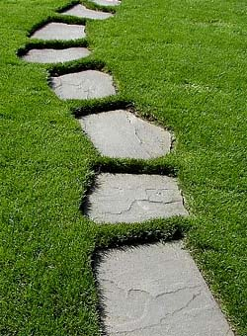
The Path to Success
In order to reach our vision for success,
what would we need to do?
Notes:
Instructions: The second discussion builds on the previous dream of success. Considering where we are now, what would the community need to do to reach its vision of success? While these do not necessarily need to be every little step along the way, the group should at least point to major tasks that would need to be accomplished.
The point of this question is to visualize the pathway from the present to the envisioned success.
Allow 25 minutes for the discussion.
Table facilitators should jot down key points.
Time: 30 minutes
Materials: Flip charts and markers for each topic facilitator

Slide 19
Resources
What resources will help us reach success?
Which do we:
Have ready to use?
Need to develop more?
Need to find?
Notes:
Instructions: The third and final discussion builds on the previous pathway discussion. Considering the pathway the community would need to take, what resources would help them reach success? Encourage the groups to consider all relevant resources including:
Ones already available and ready to use
Those that exist in the community but may need to be adapted or developed
Those that would need to be brought in or created (i.e. don’t exist in the community right now)
The point of this question is to develop a resource list that acknowledges the important resources available internally, but is also realistic about what may be missing.
One rule: They cannot write down “grants,” “funding” or any other type generic word for money. Rather they must dig down to why they need the money. Money is just a tool to get resources you need. What are the resources the community believes it would “buy” with funding? For instance, suppose a community decided it needed an after school program, but felt it was not possible with out grants. Ask, “what would you use the grant funding for?” Perhaps the answers would be to pay teachers, to buy art supplies, to purchase snacks. Then the resources needed actually are: teachers, art supplies, and snacks. By moving people past the barrier of “got to get grants,” they may be able to envision different paths to their resources. Continuing on this example, perhaps retired teachers would volunteer hours, local artists would bring materials and teach classes, and local faith based organizations would donate packaged snacks. It may not be necessary to go into this explanation prior to the discussion; however it is provided here for the sake of the coach’s understanding of the rule in case of questions.
Allow 25 minutes for the discussion.
Table facilitators should jot down the resources identified and note whether or not the resource is already in the community.
Time: 30 minutes
Materials: Flip charts and markers for each topic facilitator

Slide 20
Groups Report Out
Share a brief summary of your table’s discussion centered around the guiding questions.
Notes:
Instructions: Provide each group with a five minute time limit to summarize their three part discussion. This can be fun and upbeat by setting the stage.
Before beginning, set a timer for a couple of seconds so that the participants can hear the sound of the ending signal. Tell them that when they hear that sound, everyone starts clapping, whether the speaker is finished or not.
Then ask for a volunteer reporter that thinks they can beat the clock (5 minutes). Once the volunteer begins speaking, start the timer. If the reporter finishes before the timer, encourage them by starting a round of applause. If the timer goes off, start applauding and thank them enthusiastically (others will follow your lead and clap).
Keep it fun and upbeat, and you’re not likely to have more than one person that goes over.
Time: Varies by number of groups.
Materials: Timer with a ending signal that can be easily heard

Slide 21
Next Steps & Concluding Remarks
Notes:
Instructions: This is a wrap up slide that helps participants understand what will happen next.
While the LEAD coach (you) have taken a central role in the forum, helping the community understand their ownership is vital.
One approach: Ask the LEAD team to stand and briefly explain that these individuals have been responsible for organizing the forum and are committed to pursuing action over the coming months. (Have them continue to stand) Ask anyone that lives in the community (county/region) to stand. Speaking to them, note that they are the ones that have the most at stake in the success of the LEAD initiative. While others (like yourself) are here because they care, the ones standing have the most to gain from success. Allow people to be seated.
Then ask for a show of hands of those willing to continue to work on the priorities identified today. Thank them and tell them about the process going forward. Be sure to include the next meeting date and be sure a sign-up process is available.
If someone from the LEAD team is not already identified to gather and type the notes, you may want to solicit a volunteer from this group. HOWEVER, be sure to take pictures of all notes before they leave as a back-up. Because…life happens.
Time: 10 minutes
Materials: None

Slide 22
Notes:
Instructions: Thank participants for coming and thank any invited guests and sponsors
Time: 1 minute
Materials: None

Slide 23
Notes:
Be sure to include your contact information and logos.
Be sure to take pictures of all note pages as a back-up.

