Slide 1

Building Disaster-Resilient Places
STEP THREE – Determine Goals and Actions

Slide 2
A Review of What is Involved
Step 1: Form a Collaborative Planning Team
Step 2: Understand the Situation
Step 3: Determine Goals & Actions
Step 4: Plan Development
Step 5: Plan Preparation, Review, & Approval
Step 6: Plan Implementation & Maintenance
Step 1: Form a Collaborative Planning Team
Step 2: Understand the Situation
Step 3: Determine Goals & Actions
Step 4: Develop the Plan
Step 5: Prepare, Review, & Approve the Plan
Step 6: Implement & Maintain the Plan
Notes:
Remind participants of where they are within the process. Now that they have formed the team and examined their current situation, they are ready to get to work identifying goals and actions that form the framework of the plan.

Slide 3

Overview
In this step, your team will:
Use a scenario to start planning
Write SMART goals for your plan
Plan actions needed to reach goals
Notes:
In this step, your team will:
Learn how to use a scenario to start the planning process
Based on the scenario planning process:
Write SMART goals that respond to your key
Plan actions that will be important to help reach your goals.

Slide 4
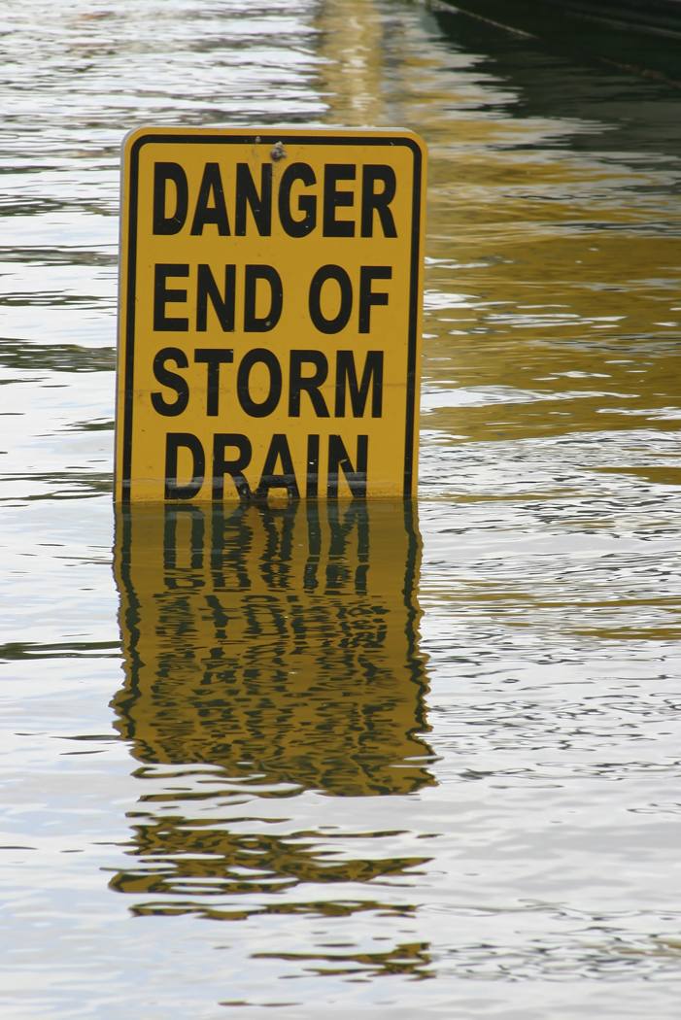
Scenario Planning:
Working Up to Goals and Actions
FLOOD!
How will you respond?
Notes:
The scenario planning is one way groups sometimes use to help think about the kinds of things they need to consider in planning. We are going to role play a flood scenario in order to get a feel for what could happen if your community experienced a disaster of this type. The scenario planning process can guide your team in determining the goals and actions that might help your community be better prepared and able to effectively respond to a disaster – such as a flood.
Facilitator Note: Feel free to change the scenario to another situation if this situation is not a good fit to the kinds of disasters your community is likely to face. You can use the basic design of the scenario provided to write your own situation, or you can search other sources for ready-made table-top exercises. A list of resources is provided to get you started. [Insert handout info on facilitator’s guide on this page]
Also, this scenario provided has multiple cascading events. Feel free to shorten the number of events or adapt them to help participants relate to the situation and/or to respond to time constraints. Be sure to make appropriate adjustments to the participant handout to reflect any changes you make to the basic scenario.

Slide 5
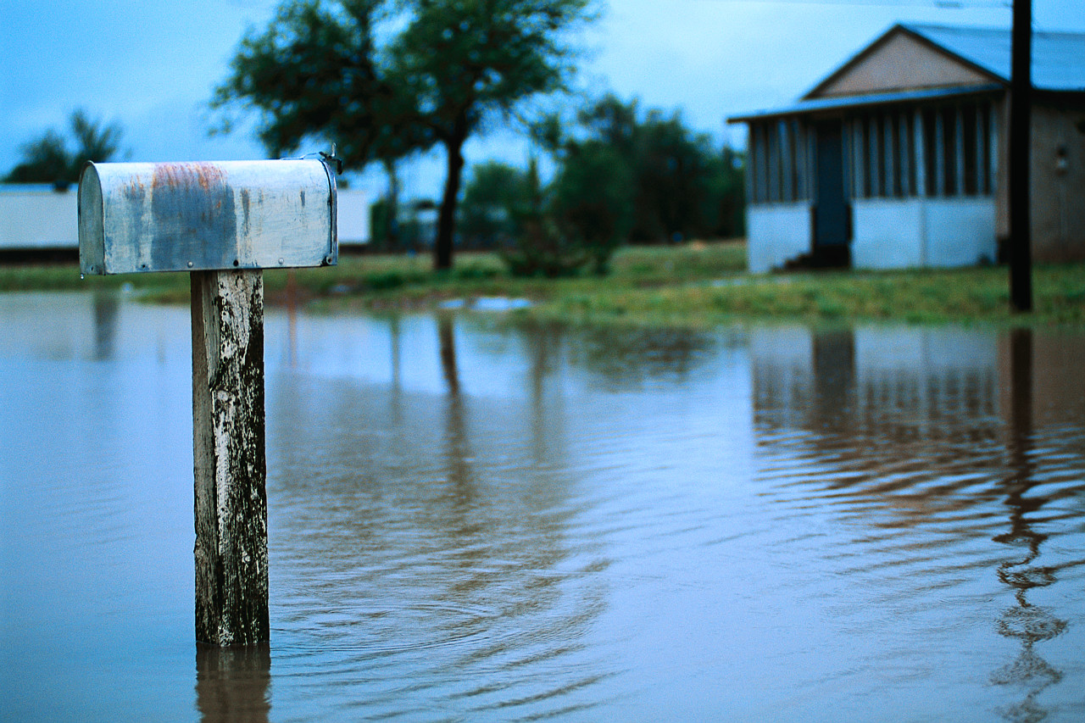
Flood Scenario Debrief
Flood Scenario Review
What challenges did you discover?
Did you identify any goals we could put into our plan?
What resources would you need? Did you have the resources you needed?
What questions did this raise?
Notes:
Now that you have gone through the scenario planning, let’s take a few minutes to think about it:
What went well?
What didn’t go well?
Good disaster planning requires clear goals and specific actions. Did you see any needed goals or actions in this process? What goals would have helped in this situation?
Did you have the resources you needed? If not, what was missing? (Note: We will discuss this in more detail in Step Four of ReadyCommunity).

Slide 6

Thinking about Your Plan
DISCUSSION.
What hazards did you identify in Step Two when you did your community’s timeline?
What needs to happen to respond to these hazards?
Notes:
As you begin to outline your plan and its goals, you should focus your discussion on the following questions:
1. What hazards did you identify in Step Two when you did your community’s timeline?
2. What needs to happen to respond to these hazards?
The next section will help us identify some of these areas that need attention.

Slide 7
Emergency Support Functions
Which of these should be part of your goals?
Emergency Support Functions
1
4
5
6
7
8
9
10
11
12
13
14
15
2
3
Notes:
FEMA has identified 15 response categories, or Emergency Support Functions (ESF) from which a community may need to respond in a disaster. All fifteen functions may not be needed for every type of hazard. Based on your hazard, which of these support functions will you need to use to respond to your hazard? Handout 2 has the descriptions of each one and can help you think through your choices.
Once you have selected the ESFs you plan to address, the next step is to write goals for each of these.

Slide 8

Developing Goals
What is a goal?
A very concrete end result that you want to achieve by a certain time.
It is a statement that is SMART
Notes:
Let’s begin by defining what we mean by “goal” and then look at elements that make goals into SMART goals.
A goal is a concrete end result to be achieved within a certain time.
Goals focus on things you want to get done or accomplish. One of the best ways to build strong goals is to make sure they are SMART.

Slide 9
SMART Goals
Specific
Measure
How will you know you reached your goal?
Able
Do you have the things you need to reach the goal?
Relates
Time
Is it something that is important in this situation?
When do you want to reach this goal?
What do you want to do?
Notes:
SMART is made up from five words that help define a solid goal. This slide shows how SMART goals are created.
S means Specific: Knowing what the community wants to achieve and where they want to focus their efforts is important. Some goals may be community-wide in focus while other goals may be targeted to a smaller geographic area or to a certain part of the community’s vulnerable population. As you develop specific goals, think through why these goals are important to the disaster planning efforts of your community.
M means Measure: Writing a goal that can be measured helps make sure you are moving in the right direction to reach your goals. Think about what you want to achieve and how you can measure your progress along the way.
A means Able: We need to be sure we have what we need to reach a goal. Are there things that might get in the way that we need to consider? Avoid embracing goals at odds with the current or anticipated resources that will be available in your community. Consider goals that align with the assets of your community. These assets could be people, volunteer groups, local institutions, or physical resources.
R means Relates: Is the goal something that the community really needs to do? Since your community may have a lot of goals related to disaster preparation, thinking about the importance and relevance of each goal is vital. Consider whether each goal will bring value to the community at large, or at least to a segment of the community that may be especially vulnerable to the hazards your community is facing.
T means Time: Having timelines for each of your goals is important. If you don’t have target dates or timeframes, then you are likely going to muddle along, having no clear idea of what actions need to be taken and by when. In order to keep things on track, build a timeline of when your team goals are to be completed.

Slide 10
SMART Goal: Example
ESF# 4: Firefighting
Example:
  Not SMART – Improve coordination of local volunteer fire departments for responding to large scale fires.
  SMART – By July 14, 2015, develop a shared county-wide communication plan that will alerts all county volunteer fire departments within ten minutes of a large scale fire call.
Time
Specific
Able
Relates
Measure
Notes:
We want to share with you an example of a goal that is “not so SMART.” The goal focuses on the response of the local volunteer fire department, something that is important in small towns or cities without full-time paid fire department staff. But many of the SMART elements are missing from the first example.
At the bottom of the slide, this goal has been changed to have the five parts of a SMART goal. Take a look at the five labels to see different parts of the goal. Keep in mind that a goal does not have to be long or complicated to have SMART parts.

Slide 11
SMART Goal: Example
ESF#15: Emergency Public Information
Specific
Not SMART: Alert everyone of a flood threat.
Can you identify the SMART elements included in the following goal?
SMART – All of people in the county’s flood-prone area will be told within 4 hours when a flood threat has been issued by emergency officials.
Measure
Able
Relates
Time
Notes:
Now it is your turn. Here is a goal about telling people in a flood prone area about the need to evacuate. The first statement fails to meet the conditions of being a SMART goal. However, the second statement is SMART. See if you can identify each of the SMART elements.
Facilitator note: This can be done in small groups or individually allowing time to report back, or together as a whole group, depending on the size of the whole group.
Specific: telling persons in the county’s flood-prone area
Measure: 100%, within 4 hours
Able: County level, within a defined area
Relates: People in flood zone
Time: Within four hours of the order

Slide 12

Working on SMART Goals
For each ESF you picked
write a SMART goal
for what needs to happen.
Notes:
Facilitator Note: Have blank flip chart paper available for participants. Once they identify the ESFs they want to address, write each one at the top of a separate flip chart sheet (one ESF per sheet). Ask each person to pick an ESF that he/she wants to tackle (individually or in small groups). After everyone has selected an ESF, instruct the group of people assigned to each of the ESFs to write a SMART goal related to that specific function. After each team has completed its assignment, ask a representative of each ESF team to share the goal they developed. Ask the other participants to provide feedback on ways to refine each of the ESF goals.

Slide 13
Moving from Goals to Actions
SMART GOAL: All of people in the county’s flood-prone area will be told within 4 hours when a flood threat has been issued by emergency officials.
We have a SMART Goal,
but now we need action.
What would you do?
Notes:
The next step is to come up with actions to reach goals.
Activity: have group think about sample goal (100% of persons in county’s flood prone area will be notified within 4 hours of an evacuation order release) and brainstorm what they would do. List answers on the flip chart.
If participants are stuck, use Handout 4 as a guide.

Slide 14

Ready for Action
Using your ESF SMART goals,
write the actions that will help
you reach your goal.
Notes:
Working in the same teams that developed the SMART goal(s) for specific ESFs, have each group develop a list of actions (not specific steps) that will be needed to reach the goal. Once each group has a good working draft, allow time to share with the others who are part of the larger team.
Facilitator Note: When using Handout 3, be sure the participants are developing big picture actions in the “Action” section and not specific steps. We will discuss the specific steps needed to achieve the goals in Step 4.

Slide 15

Finish Goals and Actions
By the next meeting:
Finish the SMART goals and actions
Be ready to share at the next meeting
Notes:
Have each group finish SMART goals and actions before the next meeting. Since Step 4 builds on the information generated in Step 3, cleaning up any “fuzzy” or unclear items before the next session will help the group make progress. Polished versions of Handout 3 should then be shared and discussed at the beginning part of the upcoming Step 4 session.

Slide 16

Questions and Next Steps
  Any questions about:
    Today’s work?
    Work before next meeting?
Next meeting: date, time, place
Notes:
Take a few moments at the end of this session to answer any questions about the day’s work or any work assignments before the next meeting. Also, be sure to announce the time, date, and location for the next meeting.

Slide 17
Contact Information
Building Disaster-Resilient Places

