Slide 1
Building Disaster-Resilient Places
STEP TWO – Understanding the Situation

Slide 2
A Review of What is Involved
Step 1: Form a Collaborative Planning Team
Step 2: Understand the Situation
Step 3: Determine Goals & Actions
Step 4: Plan Development
Step 5: Plan Preparation, Review, & Approval
Step 6: Plan Implementation & Maintenance
Step 1: Form a Collaborative Planning Team
Step 2: Understand the Situation
Step 3: Determine Goals & Actions
Step 4: Develop the Plan
Step 5: Prepare, Review, & Approve the Plan
Step 6: Implement & Maintain the Plan

Slide 3

Overview
Part I. Setting the Stage – Disaster Management 101
  Disaster defined
  Resiliency and vulnerability
Part II. Community Based Vulnerability Assessment
Part III. Ground-truthing

Slide 4
Part One
Part I. Setting the Stage – Disaster Management 101
  Disaster defined
  Resiliency and vulnerability
Part II. Community Based Vulnerability Assessment
Part III. Ground-truthing

Slide 5
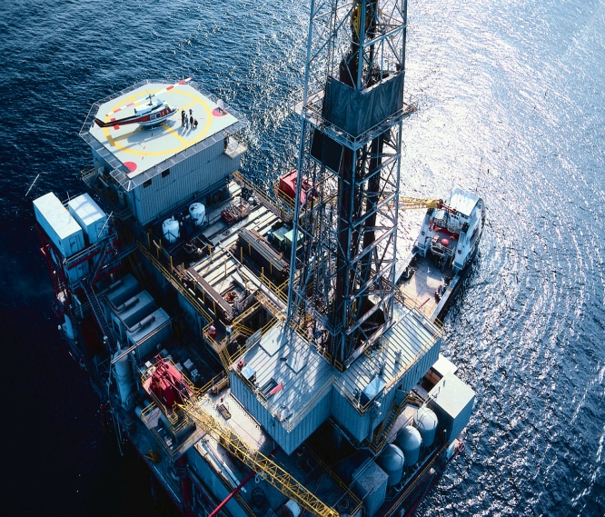
Hazards and Disasters Defined
Hazards:
  Natural catastrophe
  Technological accident
  Human caused sources of harm
Disaster: Occurrence of a hazard that results in severe property damage, multiple injuries or deaths
Large-Scale: Disasters that overwhelmed local capacity

Slide 6
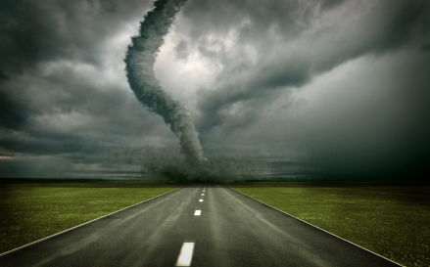
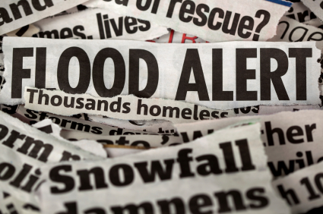
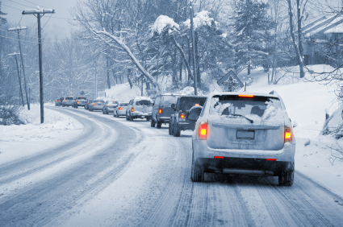
Hazards in Your Community
What hazards are your community likely to encounter?
Are these hazards related to:
  Natural occurrences
  Built environment
How would you rank these hazards according to:
  Frequency
  Severity of risk
Where can you find more information about these?

Slide 7
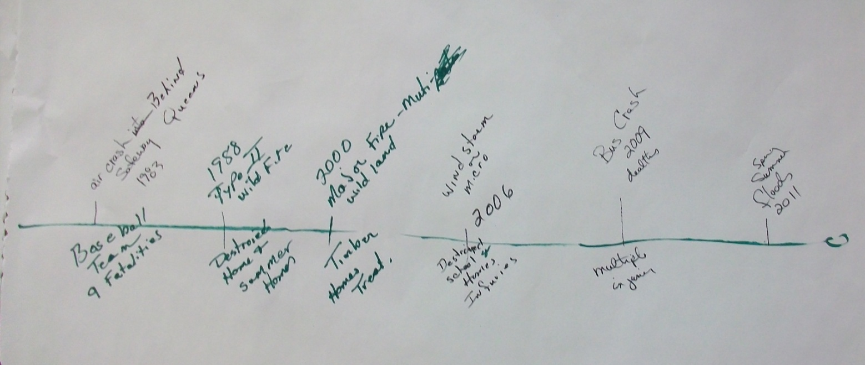

Community Hazards Timeline
Develop a disaster timeline going as far back as you can remember
Be prepared to briefly explain your timeline to other participants

Slide 8
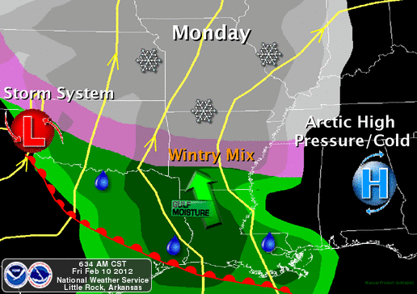

Vulnerability and Resilience
What determines impacts of disasters?
HAZARDS
VULNERABILITY
IMPACTS

Slide 9

Vulnerability in Your Community
Refer back to Vulnerable Populations list from Step One.
    Who else may be vulnerable in your community?
    Why are these groups of people vulnerable?

Slide 10

Community Capacity and Resiliency
Communities can build capacity and become more resilient by:
  Decreasing vulnerability
  Increasing hazard mitigation
  Increasing collaboration through planning
  Increasing community-wide communication

Slide 11
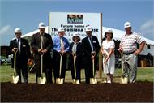

Community Capacity and Resiliency
Community Capacity: the ability to mobilize resources
Resilience: “The ability to resist, absorb, recover from, or adapt to an adverse occurrence.” FEMA, 2010
BOUNCE

Slide 12
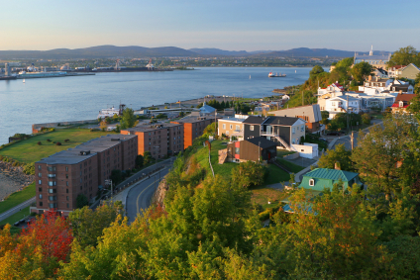
Resilient Communities
Resilient Communities are characterized by:
  Sound and/or fortified infrastructure
  Access to diverse community resources
  Strong communication avenues
Involvement of a diverse planning group
Ability of local groups to work together and mobilize collective resources

Slide 13
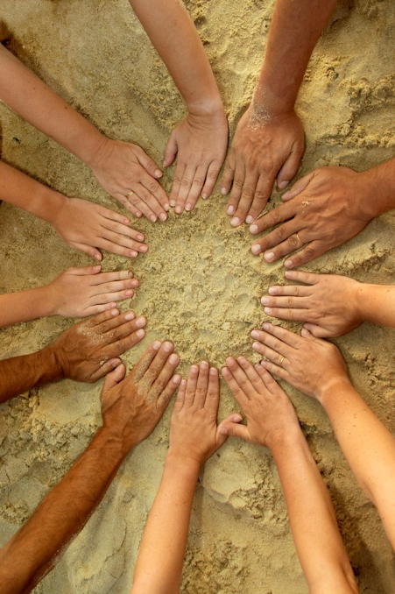
Resilient Communities
“Engaging the community in the planning process will improve community resilience by:
Increasing the understanding of threats and hazards,
Participating in the planning process, and
Communicating the expected actions for the community to undertake during an emergency.”
FEMA, 2010

Slide 14
Part Two
Part I. Setting the Stage – Disaster Management 101
  Disaster defined
  Resiliency and vulnerability
Part II. Community Based Vulnerability Assessment
Part III. Ground-truthing

Slide 15
Community Based Vulnerability Assessment
The CBVA Guidebook:
Is user-friendly
Complements FEMA guidance
Is designed to engage communities in the understanding of social and physical vulnerabilities to disaster
Was developed in FEMA-funded Emergency Preparedness Demonstration Project
Was prepared by MDC, Inc. and UNC Institute for the Environment in Chapel Hill, N.C.

Slide 16

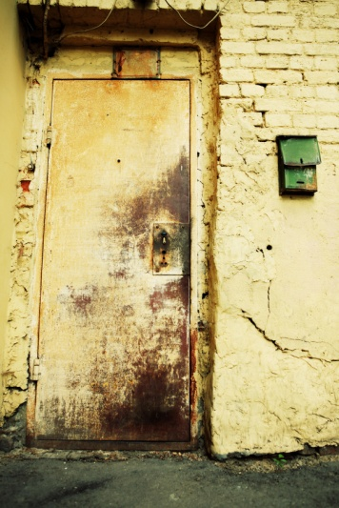
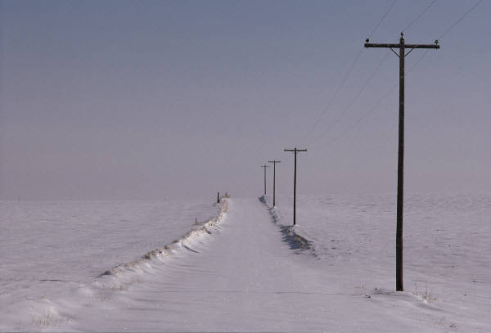
Community Based Vulnerability Assessment
Assessing the at-risk:
    People
    Buildings
    Communications links

Slide 17

Community Based Vulnerability Assessment
Task 1 – Getting Started
Organize a team that will conduct the assessment
Identify and list vulnerable populations in the community*
Start with what you have
  HINT: Worksheets 1-4 will help you get organized
  *We will explore how to find this information at
  the end of this session.

Slide 18
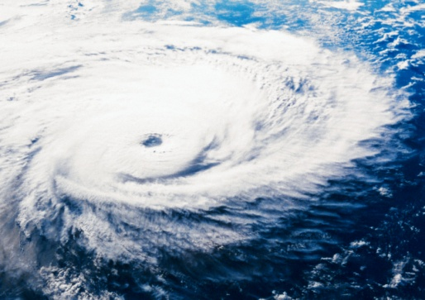
Community Based Vulnerability Assessment
Task 2 – Identify and Rank Hazards
  List different types of hazards that have occurred or could occur in
  the community
  Rank each hazard based on the frequency and severity of risk
  HINT: Refer back to the disaster timeline you created in Part I. Worksheets 5 and 6 will help you identify and rank hazards.

Slide 19
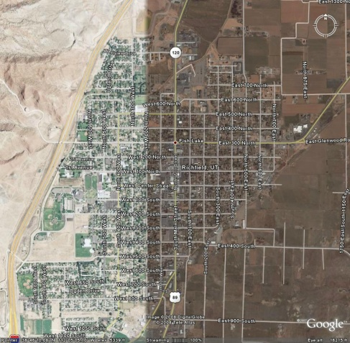
Community Based Vulnerability Assessment
Task 3 – Map Areas of Greatest Risk
  Prepare a base map of your community
  Map specific areas vulnerable to disasters:
      Bridges
      Hospitals
      Roadways that have flooded in the past
      Neighborhoods that have flooded
      Other important features

Slide 20
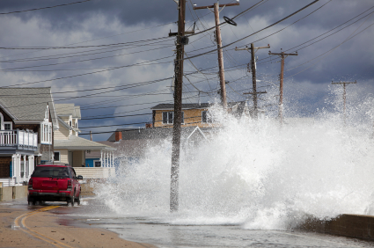
Community Based Vulnerability Assessment
Task 4 –Identify and Map Physically Vulnerable People & Property
  Inventory and map critical facilities located in hazard-prone areas
  Estimate the number and value of residential structures currently located in hazard-prone areas
  Estimate the number of people who live in these structures
  Estimate future numbers and values of residential structures that will be located in hazard-prone areas
  HINT: Use Worksheets 7-9.

Slide 21

Community Based Vulnerability Assessment
Task 5 – Identify and Map Socially Vulnerable Populations
  Gather information on number, location, needs, and capabilities of socially vulnerable people by contacting:
    Non-profits
    Faith-based organizations
    Government agencies
  Prepare maps of social vulnerability
  HINT: Use maps you created in CBVA Task 3.

Slide 22

Community Based Vulnerability Assessment
Task 6 – Identify and Map Employment Centers
  Prepare list of employment centers in the community
    Include current and future locations
    Estimate the number of employees
  Map location of major employers and highlight those located in known hazard-prone areas
  HINT: Use Worksheet 10 to organize info.
  Plot on maps created in CBVA Task 3.

Slide 23
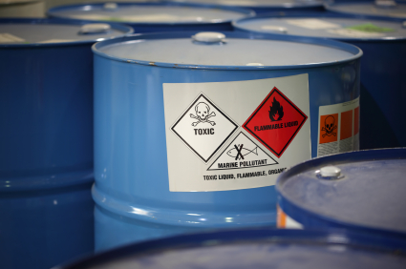
Community Based Vulnerability Assessment
Task 7 – Inventory and Map Environmental Threats
  List facilities that handle dangerous substances
  Add these facilities on base map, highlighting those in hazard-prone areas
  Determine the number of persons that could be at risk
  Rank facilities in order of the severity of threat
  HINT: Use Worksheet 11 and maps created
  in CBVA Task 3.

Slide 24

Organizing the CBVA for Your Community
Identify CBVA Taskforce members
Determine leadership for each task
Review worksheets associated with each task
Identify resources for addressing questions
Determine dates for completing Tasks 1-7
Set a deadline for assembling comprehensive report
Plan for ground truthing (Task 8).
HINT: Use the CBVA Taskforce Organization Worksheet to help you organize

Slide 25
Part Three
Part I. Setting the Stage – Disaster Management 101
  Disaster defined
  Resiliency and vulnerability
Part II. Community Based Vulnerability Assessment
Part III. Ground-truthing

Slide 26
When to Involve the Community
Three Touch-Points in the Planning Process
Step 1: Form a Collaborative Planning Team
Step 2: Understand the Situation
Step 3: Determine Goals & Actions
Step 4: Plan Development
Step 5: Plan Preparation, Review, & Approval
Step 6: Plan Implementation & Maintenance
Verify and strengthen information gathered
Review the plan. Identify additional assets. Make suggestions to strengthen
Communicate the plan. Involve the community in staying ready.
*Assets can include volunteers, equipment, facilities, etc.

Slide 27
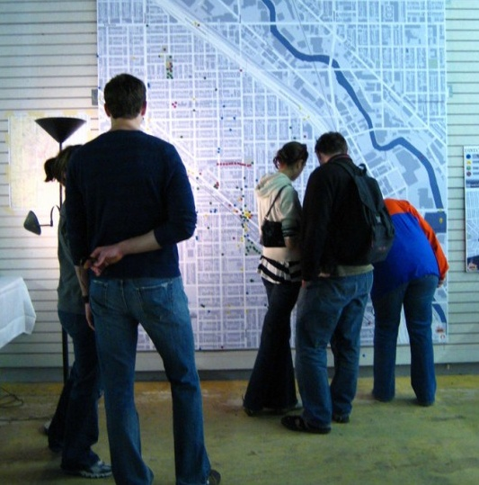
Community Based Vulnerability Assessment
Task 8 – Community Ground-Truthing
Definition: (military term) ensuring that intelligence gathering matches what is true on the ground
Goal: to ensure the accuracy of the community’s maps and data
Strategy: Community Open House

Slide 28
Typical Open House Structure
Station
Station
Station
Welcome Table
Refreshments
Enter
Comment Area
Station
Exit
Table
Station
Exit

Slide 29

Preparing for the Open House
Complete CBVA Tasks 3-7 and Worksheets 1-11
Prepare community maps
Determine locations, dates and times
Send invitations and announcements

Slide 30
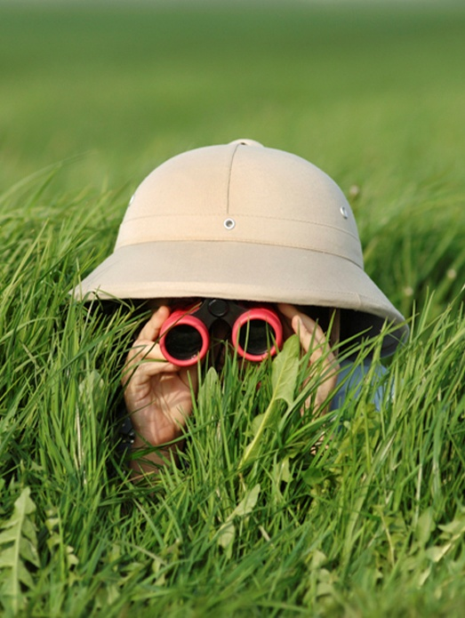
Where is Everyone?
Where do people in your community…
Gather on a regular basis?
Visit at least once a week?
Feel comfortable meeting?
Answers to these questions guide:
The location of the open house
How to spread the word about the event

Slide 31

After the Ground-Truthing
Examine the feedback from participants
Adjust the maps and other data
Provide feedback to the participants:
  Thank them
  Include a summary of how their input helped
  Invite them to the next community session

Slide 32

Finding the Data
Resources to identify and list vulnerable populations
in the community (CBVA Task 1)

Slide 33
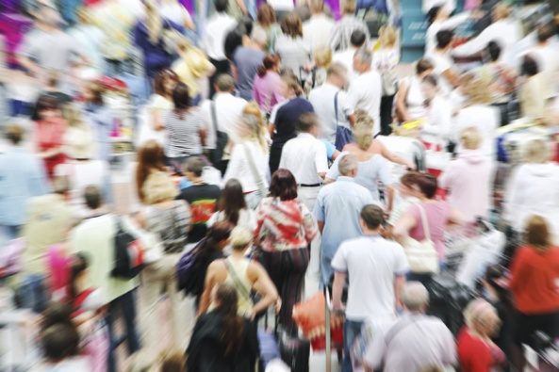
How Well Do You Know Your Community?
Demographics help:
    Describe the community
    Identify vulnerable populations
Elements of the population to consider:
    Race/Ethnicity
    Age
    Socioeconomic status
    Family structure

Slide 34

Population Trends: Window to the Future
Recent national trends show increases in:
  Minority populations (especially Hispanics)
  Elderly population
  Economically disadvantaged populations
  Single-parent households
  One-person households
Are these trends happening here?
Why might these be important to know in disaster planning?

Slide 35

Where Is the Data?
Southern Rural Development Center http://srdc.msstate.edu/readycommunity
Western Rural Development Center http://wrdc.usu.edu/htm/regional-data
Census Data
www.census.gov
State data centers and universities
  Who else in the community who could assist with this research?

Slide 36

Wrap Up
Assessments help us understand the situation – our vulnerability and our potential for resilience.
  DISCUSSION:
  What are some important insights we may gain through this assessment?

Slide 37
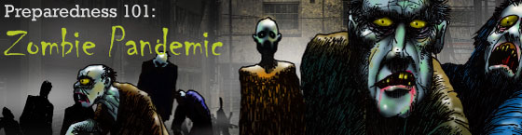
CDC Zombie Preparedness 101
Zombie Preparedness. Center for Disease Control and Prevention, 2011.
Are we prepared at home?
  “If you are generally well equipped to deal with a zombie apocalypse you will be prepared for a hurricane, pandemic, earthquake, or terrorist attack.”
  Dr. Ali Kahn, CDC Director
http://www.cdc.gov/phpr/zombies

Slide 38

MAKE A PLAN
BUILD A KIT
MAKE A PLAN
BE INFORMED
http://www.ready.gov/
http://emergency.cdc.gov/

Slide 39

Questions & Discussion
Timeline
Next meeting date
“To do” list
Other discussion/questions

Slide 40
Contact Information
Building Disaster-Resilient Places

