Slide 1

Building Disaster-Resilient Places
STEP THREE – Determine Goals and Actions

Slide 2
A Review of What is Involved
Step 1: Form a Collaborative Planning Team
Step 2: Understand the Situation
Step 3: Determine Goals & Actions
Step 4: Plan Development
Step 5: Plan Preparation, Review, & Approval
Step 6: Plan Implementation & Maintenance
Step 1: Form a Collaborative Planning Team
Step 2: Understand the Situation
Step 3: Determine Goals & Actions
Step 4: Develop the Plan
Step 5: Prepare, Review, & Approve the Plan
Step 6: Implement & Maintain the Plan
Notes:
Remind participants of where they are within the process. Now that they have formed the team and examined their current situation, they are ready to get to work identifying goals and actions that form the framework of the plan.

Slide 3

Overview
In this step, your team will:
Learn about scenario planning
Test the scenario planning process
Explore the elements of SMART goals
Create SMART goals that respond to your key hazards
Outline actions needed to accomplish goals
Notes:
In this step, your team will:
Learn about scenario planning, a process that can help you imagine how hazards/threats could play out in your community.
Test the scenario planning process by conducting a tabletop exercise that deals with a major flood impacting a community.
Explore the elements of SMART goals
Based on the scenario planning process:
Create SMART goals that respond to your key hazards (using the document that provides a complete listing of the Emergency Support Functions, or ESFs, that might be most relevant in preparing for or responding to this hazard).
Outline actions that will be important to help accomplish your goals.

Slide 4

Scenario Planning: What is It?
A way to develop long-term plans based on:
Assessment of hazards/threats the community may face
Exploration of “What If” situations related to those threats or hazards
Examination of goals and actions that can help your community respond effectively
Notes:
Scenario planning helps put a “real life” situation around the planning process. It begins with an assessment of the current hazards and threats which was completed during Step Two, then follows with an exploration of what would happen if the community experienced one of those key threats or hazards. Finally, scenario planning helps the community identify goals and actions that can help improve the chances that the community will respond in an effective manner to these hazards/threats.

Slide 5
Stages of Scenario Planning
Identifying
Threats
Identify hazard/threat you want to address.
Is hazard/threat one that can be applied to a scenario planning activity?
Assessing
Vulnerability
Building
Scenarios
Generating Options
Use results of the first two stages to focus on the scenario you wish to explore.
Identify the major factors affecting your community’s vulnerability to the identified hazard or threat.
Testing Options
Develop possible goals for addressing your scenario.
What goals can your community select to either respond to or mitigate the threat?
Begin Developing Action Plans
Identify possible actions related to each goal being considered
Ask yourself, “How well will each of the possible actions work in my community?”
Determine the nature & level of the community’s vulnerability.
Can your community do something about the hazard or threat?
Decide on actions you want to address related to the goals you have identified.
Develop actions that best fit each of your goals.
Adapted from: JISC InfoNet, 2011.
Notes:
This chart shows the flow of scenario planning, moving from left to right. The first two stages, identifying threats and assessing vulnerabilities, were completed in Step Two of ReadyCommunity. The latter four stages will be explored during this session.

Slide 6
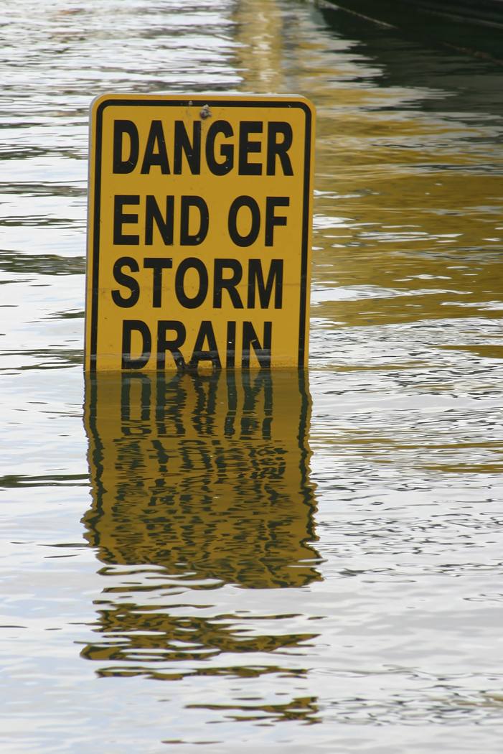
Scenario Planning:
Working Up to Goals and Actions
FLOOD!
How will you respond?
Notes:
The scenario planning process we outlined in the previous slide entails a six stage process. We are going to role play a flood scenario in order to get a feel for what could happen if your community experienced a disaster of this type and magnitude. The scenario planning process can guide your team in determining the goals and actions that might ultimately help your community be better prepared and able to effectively respond to a disaster – such as a flood.
Facilitator Note: Feel free to change the scenario to another situation if this situation is not a good fit to the kinds of disasters your community is likely to face. You can use the basic design of the scenario provided to write your own situation, or you can search other sources for ready-made table-top exercises. A list of resources is provided to get you started.
Also, this scenario provided has multiple cascading events. Feel free to shorten the number of events or adapt them to help participants relate to the situation and/or to respond to time constraints. Be sure to make appropriate adjustments to the participant handout to reflect any changes you make to the basic scenario.

Slide 7
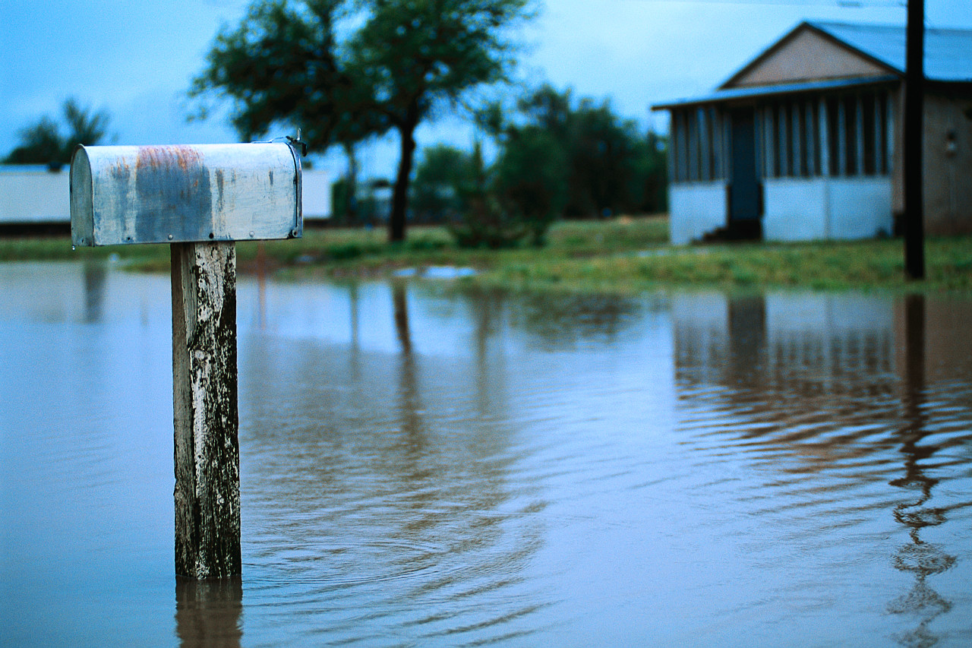
Flood Scenario Debrief
DISCUSSION.
What went well?
What didn’t go well?
Did you identify solid goals?
Did you have the resources you needed?
What questions did this raise?
Notes:
Now that you have gone through the scenario planning, let’s take a few minutes to examine the following questions:
What went well?
What didn’t go well?
Sound disaster planning requires solid goals and specific actions. Were these evident during your scenario planning activity? If not, would having goals and actions clearly developed prior to experiencing a flood been of help to you?
Did you have the resources you needed? (Note: We will discuss this in more detail in Step Four of ReadyCommunity).

Slide 8

Thinking about Your Plan
DISCUSSION.
What top hazards did you identify in Step Two?
What needs to happen to respond to these hazards?
Notes:
As you begin to outline your plan and its goals, you should focus your discussion on the following questions:
What are the top hazards that most concern you and your community as identified in Step Two?
What needs to happen to respond to these hazards?

Slide 9
Emergency Support Functions
Which of these should become part of your goals?
Emergency Support Functions
1
4
5
6
7
8
9
10
11
12
13
14
15
2
3
Notes:
FEMA has identified 15 response categories, or Emergency Support Functions (ESF) from which a community may need to respond in a disaster. All fifteen functions may not be needed for every type of hazard. Based on your hazard, which of these support functions will you need to activate in response to the situation? Handout #___ has the descriptions of each one and can help you think through your choices.
Once you have selected the ESFs you plan to address, the next step is to write goals for each the support functions you have selected.

Slide 10

Developing Goals
What is a goal?
An observable and measurable outcome that you want to achieve within a specific period of time.
It is a statement that is SMART
Notes:
Let’s begin by defining what we mean by “goal” and then look at elements that make goals into SMART goals.
A goal is an observable and measurable end result having one or more objectives to be achieved within a certain timeframe.
Goals focus on accomplishments. One of the best ways to build strong goals is to make sure they meet the requirements of a SMART goal.

Slide 11
SMART Goals
Specific
Why is this goal important?
Measurable
How do you plan to measure progress towards your goal?
What is the end result as well as the milestones along the way?
Attainable
Do you have the resources to achieve the goal? (People, organizations, money, physical resources, skills, attitude, etc.)
Relevant
Time Framed
Is this an important enough goal for your community to pursue?
Where will you focus your efforts?
When do you want to achieve this goal?
What is the target date for accomplishing the goal?
What do you want to achieve?
Are there factors that might prevent you from achieving these goals?
Is it one that will bring benefit to your community?
Is it something that matters (or should matter) to your community?
Notes:
SMART is an acronym that helps define a solid goal. This slide outlines the characteristics of SMART goals and provides a few guiding thoughts for each.
S means Specific: Knowing what the community wants to achieve and where they want to focus their efforts is important. Some goals may be community-wide in focus while other goals may be targeted to a smaller geographic area or to a certain segment of the community’s vulnerable population. As you develop specific goals, think through why these goals are important to the disaster planning efforts of your community.
M means Measurable: Develop measures that will allow you to document whether you are moving in the right direction in terms of achieving your goals. Think about the ultimate outcomes you want to achieve and the measures you want to use to document your progress along the way.
A means Attainable: Avoid embracing goals at odds with the current or anticipated resources that will be available in your community. Consider goals that align with the assets of your community. These assets could be people, volunteer groups, local institutions, or physical resources.
R means Relevant: Is the goal something that the community is genuinely committed to tackling? Since your community may have a variety of goals it may want to pursue related to disaster preparation and management, taking a hard look as to the importance and relevance of each specific goal is vital. Consider whether each goal will bring benefit to the community at large, or at least to a segment of the community that may be especially vulnerable to the hazards your community is a risk of experiencing. If it will, then it can be judged as relevant.
T means Time-Framed: Having timelines for each of your goals is important. If you don’t have target dates or timeframes, then you are likely going to muddle along, having no clear sense of what key actions need to be undertaken and by when. In order to keep things on track, build a timeline of when your team goals are to be realized.

Slide 12
SMART Goal Example
ESF# 4: Firefighting
Example:
  Not SMART – Improve coordination of local volunteer fire departments for responding to large scale fires.
  SMART – By July 14, 2013, develop and adopt a county-wide communication system that will allow alerts to reach all county volunteer fire departments within ten minutes of a large scale fire detection.
Time-Framed
Attainable
Specific
Measurable
Relevant
Notes:
We want to share with you an example of a goal that is “not so SMART.” The goal focuses on the response of the local volunteer fire department, something that is important in small towns or cities without full-time paid fire department staff. But many of the SMART elements are missing.
At the bottom of the slide, this goal has been revised to meet the five elements of a SMART goal. Take a look at the five labels assigned to different parts of the goal statement. Keep in mind that a goal does not have to be too long or technical to capture all the important SMART elements.

Slide 13
SMART Goal: Example
ESF#15: Emergency Public Information
Specific
Not SMART: Alert everyone in the flood-prone areas of a flood threat.
Can you identify the SMART elements included in the following goal?
SMART – 100% of persons in the county’s flood-prone area will be notified within 4 hours of an evacuation order being issued by state or county/local emergency management personnel.
Measurable
Attainable
Relevant
Time-Framed
Notes:
Now it is your turn. Here is a goal about alerting people in a flood prone area about the need to evacuate. The first statement fails to meet the conditions of being a SMART goal. However, the second statement is SMART. See if you can identify each of the SMART elements. For example, what portion of the SMART goal addresses the “measurable” element of the goal? How is it time-framed?
Facilitator note: This can be done in small groups or individually allowing time to report back, or together as a whole group, depending on the size of the whole group.
Specific: Notification of persons in the county’s flood-prone area
Measurable: 100%, within 4 hours
Attainable: County level, within a defined area
Relevant: People in flood zone
Time-framed: Within four hours of the order

Slide 14

Getting to Work on SMART Goals
For each ESF that your team has identified as relevant to your hazard, write a SMART goal that describes what you want to achieve.
Notes:
Facilitator Note: Have blank flip chart paper available for participants. Once they identify the ESFs they want to address, write each one at the top of a separate flip chart sheet (one ESF per sheet). Ask each participant to select an ESF that he/she wants to tackle (individually or in small groups). After everyone has selected an ESF, instruct the group of people assigned to each of the ESFs to write a SMART goal related to that specific function. After each team has completed its assignment, ask a representative of each ESF team to share the goal they developed. Ask the other participants to provide feedback on ways to refine each of the ESF goals.

Slide 15
Thinking through Goals & Actions
ESF#15: Emergency Public Information
SMART GOAL: 100% of persons in the county’s flood-prone area will be notified within four hours of an evacuation order being issued by state or county/local emergency management personnel.
Actions to be Performed:
Within six months, devise a neighborhood communication plan using both established local organizations and trained volunteers to communicate warnings.
Within three months, develop a plan to broadcast emergency information using all available media outlets serving the local area, giving particular attention to hearing impaired resources as well as non-English speaking outlets.
Notes:
Working on the same flip charts that the team used to list each ESF and its associated goals, ask participants to begin detailing the key actions/strategies that will be necessary in order to achieve the SMART goal that has been developed for the specific ESF.
This slide provides an example of how to detail the actions needed to meet your SMART goal. It builds on the SMART goal from the previous example; that is, the one that seeks to notify people who live in the county’s flood-prone area. Actions are used to describe the specific actions that need to be taken in order to accomplish the goal. We provide two actions that can help achieve this SMART goal. It is not necessary to drill down to the detailed steps that will be needed to carry out these actions at this point. These details will be developed in the next session (Step 4). Right now, your group needs to focus on one key question, “In order to reach this goal, what actions or strategies do we need to pursue?”

Slide 16

Ready to CreateYour Actions
Using your ESF-related SMART goals, write the actions that will help you accomplish each goal.
Notes:
Working in the same teams that developed the SMART goal(s) for specific ESFs, have each group develop a list of actions to be pursued to achieve their specific ESF goal. Once each group has a good working draft, allow time for feedback from the others who are part of the larger team.

Slide 17

Homework: Refining Goals and Actions
By the next session:
Fine tune the SMART goals and actions
Be prepared to present and finalize at the next meeting
Notes:
Have each group commit to fine-tuning the SMART goals and actions they identified prior to the next meeting. Since Step 4 builds on the information generated in Step 3, cleaning up any “fuzzy” or unclear items before the next session will help facilitate progress. A Word document has been provided for documenting the goals and actions for the ESFs. Each team should plug in the information on goals and actions that was developed in today’s session on the document. Polished versions of these documents should then be distributed and discussed at the beginning part of the upcoming Step 4 session.

Slide 18

Questions and Next Steps
  Any topics need clarification?
  Any concerns about the homework to be done prior to the next meeting?
Announcement of the next meeting: date, time, location
Notes:
Take a few moments at the end of this session to clarify anything that may still be confusing. Also, be sure to announce the time, date, and location for the next meeting.

Slide 19
Contact Information
Building Disaster-Resilient Places

