Slide 1

Building Disaster-Resilient Places
STEP ONE – Forming a Collaborative Planning Team

Slide 2
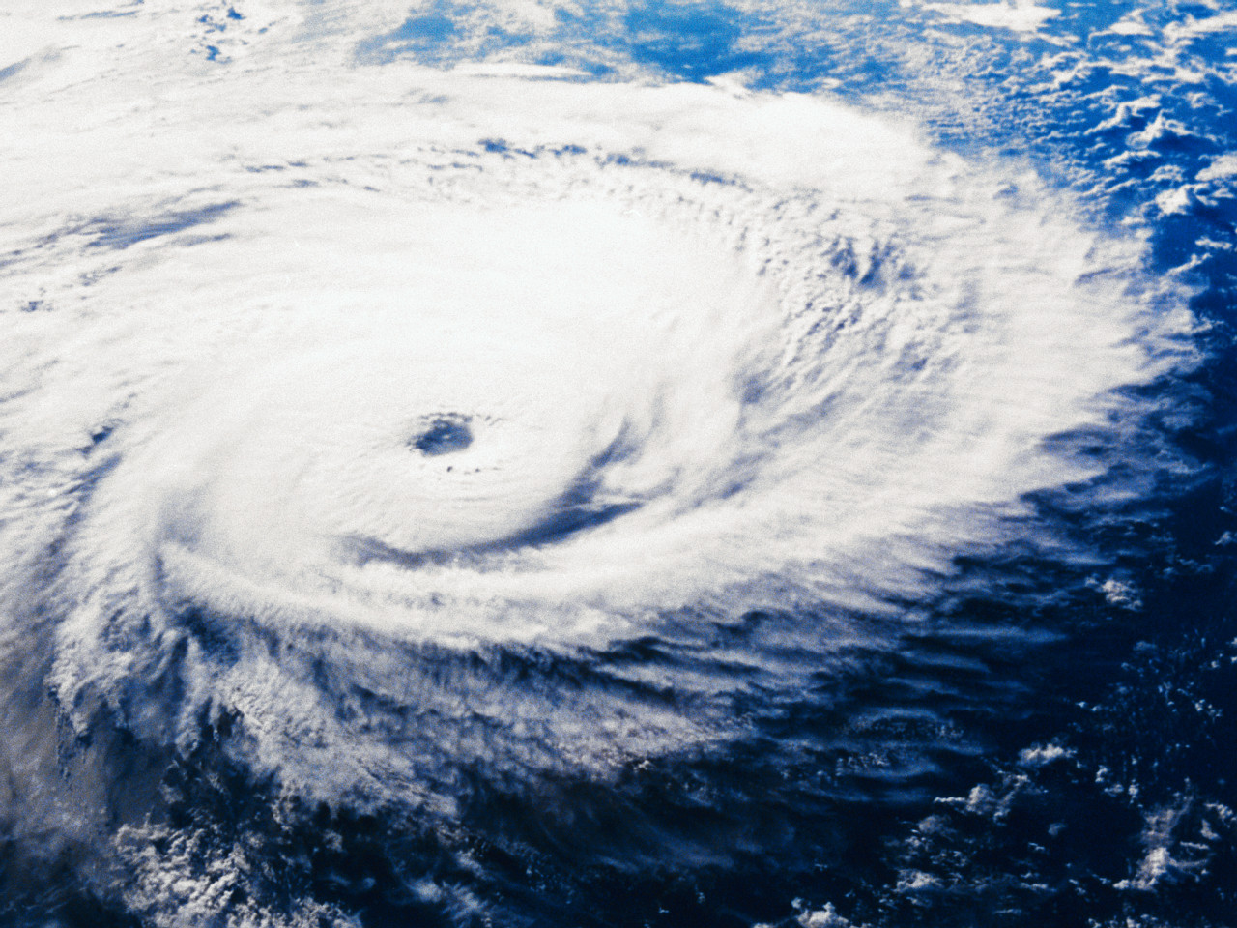
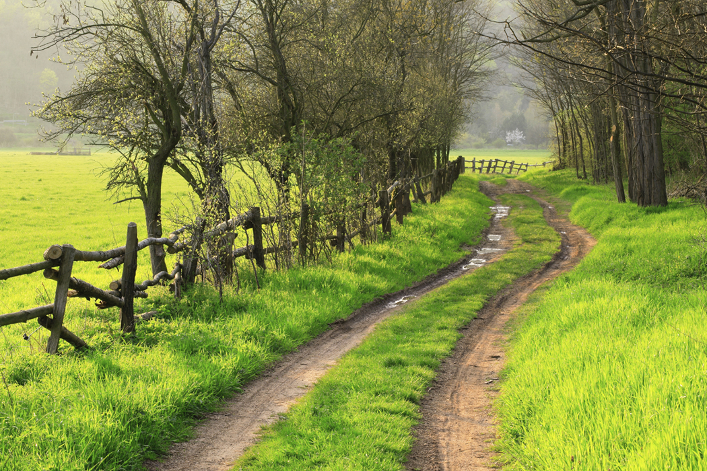
Background
Hurricanes Katrina and Rita:
Raising visibility of the nation’s most disadvantaged and vulnerable populations
Emergency Preparedness Initiative: Seeking focused strategies to help communities be better prepared
Roundtable Discoveries:
Responding to the challenges of rural communities

Slide 3
Rural Challenges
Harder to Plan
Longer to Receive Aid
Rural places seldom have dedicated staff support.
Emergency planners often wear multiple “hats.”
Remote locations are more difficult to reach.
Communication may be more difficult.
Help begins where the greatest number of people are impacted.

Slide 4
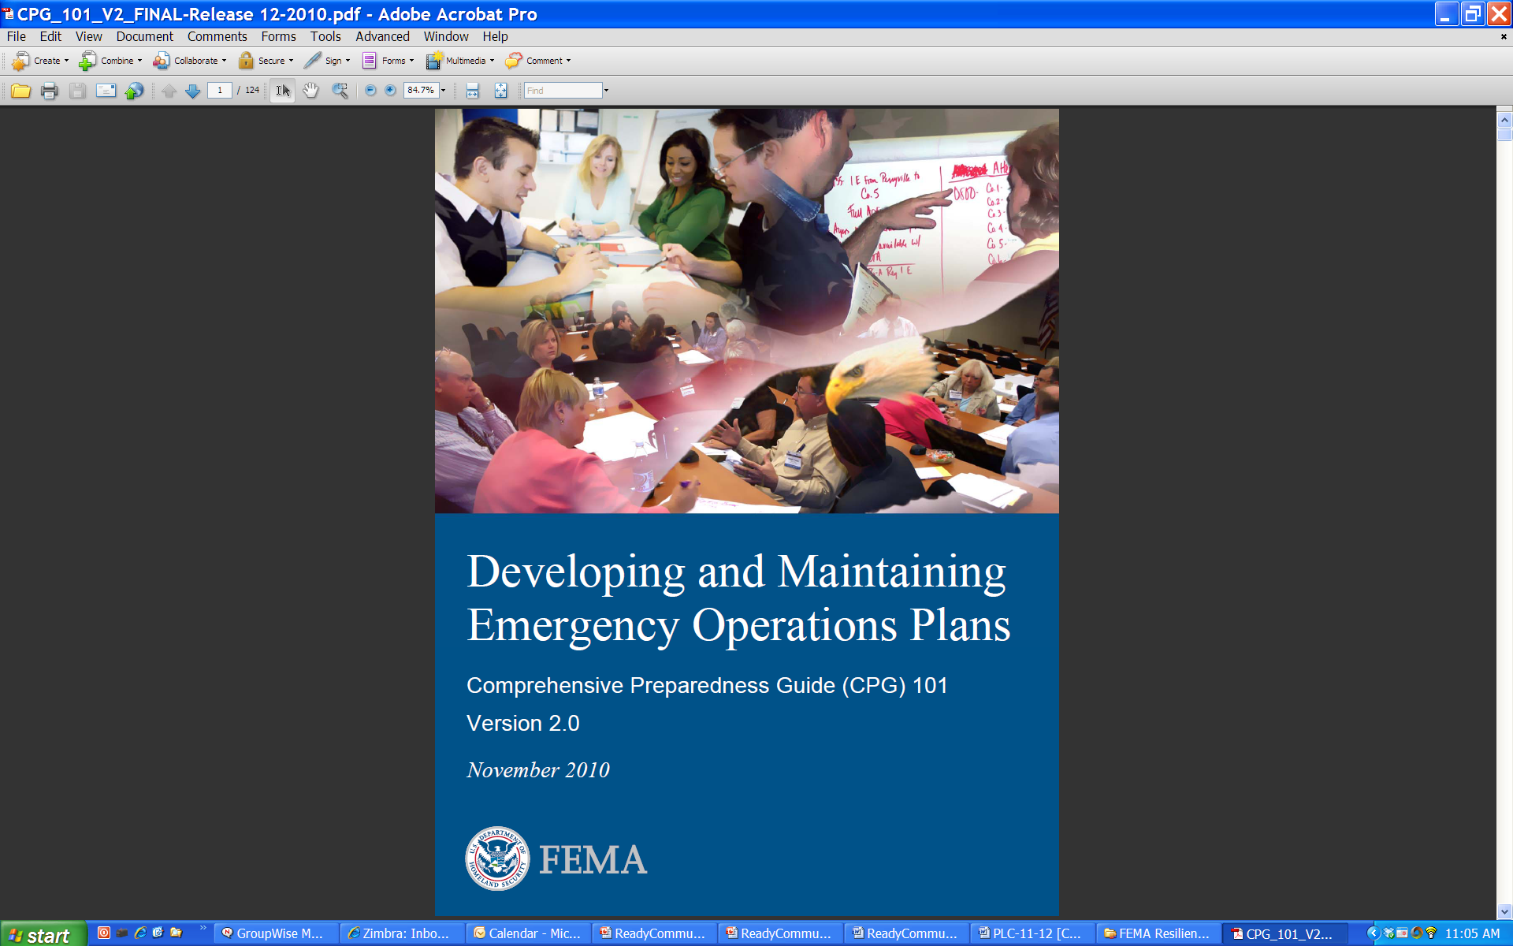
FEMA’s CPG 101
Comprehensive Preparedness Guide
Purpose of CPG 101:
  Conduct community-based planning that engages the whole community
  Ensure plans are developed through an analysis of risk
  Identify operational assumptions and resource demands
  Prioritize plans and planning efforts to support their seamless transition from development to execution for any threat or hazard
  Integrate and synchronize efforts across all levels of government

Slide 5
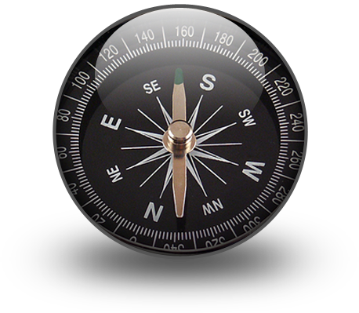
About ReadyCommunity
How ReadyCommunity Can Help:
  Provides a process to guide the work
  Is facilitated by a neutral community coach
  Fosters broad civic participation to ensure buy-in
  Creates links to needed assets and resources
  Supplies current data

Slide 6
What is Involved?
Step 1: Form a Collaborative Planning Team
Step 2: Understand the Situation
Step 3: Determine Goals & Actions
Step 4: Plan Development
Step 5: Plan Preparation, Review, & Approval
Step 6: Plan Implementation & Maintenance
Step 1: Form a Collaborative Planning Team
Step 2: Understand the Situation
Step 3: Determine Goals & Actions
Step 4: Develop the Plan
Step 5: Prepare, Review, & Approve the Plan
Step 6: Implement & Maintain the Plan

Slide 7

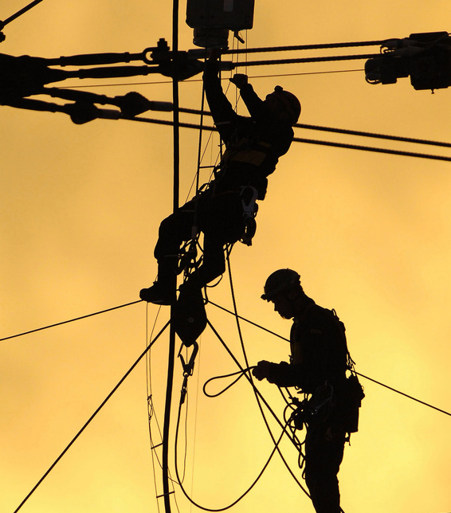
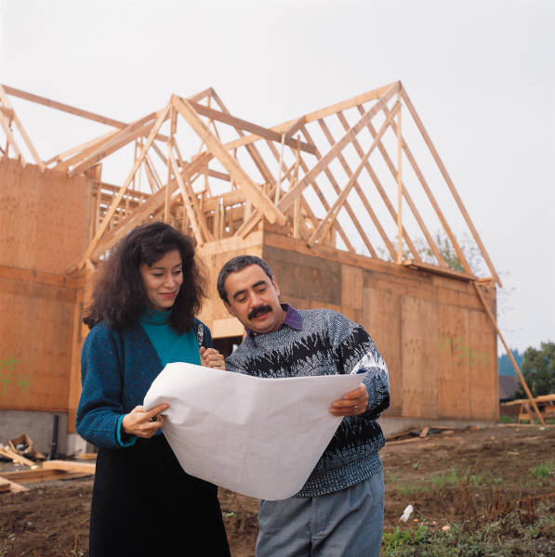
Potential Local Benefits
Decreases chances of loss of life and property – Most Important
Assists in meeting state/federal requirements for planning
Increases the amount of recovery and mitigation assistance available after a disaster
Identifies strategies to prevent or lessen loss and damage

Slide 8

Potential National Benefits
Help identify:
Ways to better support rural areas in disaster planning
Processes that make the job of planning more manageable
Avenues to foster self-preservation

Slide 9

Support Team for Plan Development
Trained ReadyCommunity Coach
Cooperative Extension Service Specialists
National Curriculum Team
Regional Rural Development Centers
Federal Partners:
  Federal Emergency Management Agency (FEMA)
  United States Department of Agricultrure (USDA)

Slide 10
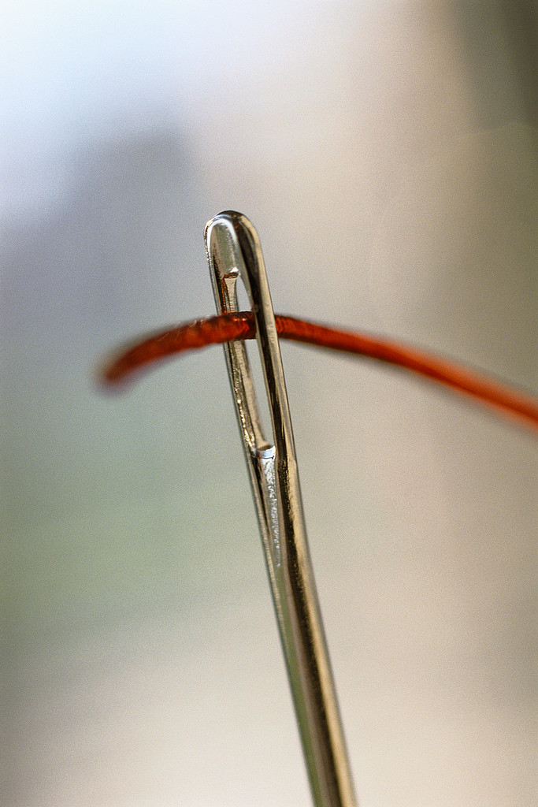
Organizing a Local Team
Why Do We Need a Team?
“…the common thread found in
successful [disaster] operations
is that participating organizations
have understood and accepted their roles.”
FEMA CPG 101, page 4-2

Slide 11
Layers of Involvement
Community
Planning Team
Core Team
Community
Coach

Slide 12

Purpose of a Community Coach
Supports the planning effort, from start to finish
Helps organize the Core Team and Planning Team
Facilitates the process that aids the Team in preparing a plan
Helps coordinate community involvement
Provides links to data and expertise available through the partners

Slide 13
Core Team Responsibilities
Guide the overall process
Recruit others
Commit to participating in sessions
Work as a team
Prepare Emergency Operation Plan
Community
Planning Team
Core Team

Slide 14
Planning Team Responsibilities
Community
Planning Team
Core Team
Participate in planning sessions
Contribute to community assessments
Help involve community
Assist in designing the emergency plan
Commit to keeping the plan current

Slide 15

Goals of the Planning and Core Team
Build and expand relationships
Bring creativity and innovation to planning
Define roles to be taken during a disaster
Understand roles and abilities of others
Establish a planning routine

Slide 16

Who Should Be at the Table?

Slide 17
FEMA Suggests…
Who else
is missing?
Planning Team
Fire Services
Emergency Manager
Law Enforcement
Health Services
Utilities
Education
Social Services
Agriculture & Farming
Children’s Services
National Guard
Civic Organizations

Slide 18
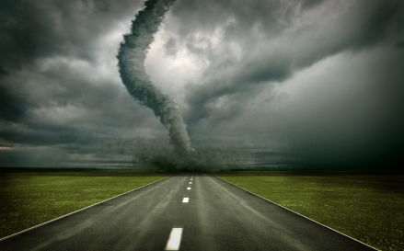
Considering Special Needs
What people or groups are most likely to have difficulty responding to a disaster in your community?

Slide 19
How to Involve Others in Planning
What can the core team learn or gain from their involvement?
What can the partners learn or gain from their involvement?
Disaster
Core Team
Community Organizations and Individuals
Creating a Win-Win Partnership

Slide 20
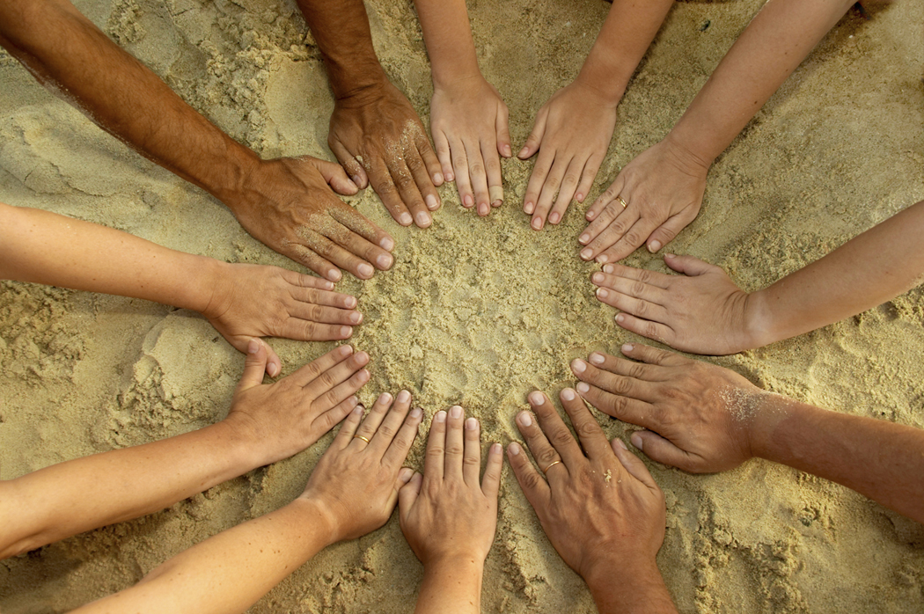
Engaging the Community in Planning
“Planning that is for the whole community and involves the whole community is crucial to the success of any plan.”
Reactions?
CPG 101, Page 4-4

Slide 21
Goals of Community Involvement
Validate assumptions
Identify resources
Foster community trust and respect
Share responsibility
Increase effective responses
Improving community support and buy-in
Improve the quality of the decisions
Community
Planning Team
Core Team

Slide 22
When to Involve the Community
Three Touch-Points in the Planning Process
Step 1: Form a Collaborative Planning Team
Step 2: Understand the Situation
Step 3: Determine Goals & Actions
Step 4: Plan Development
Step 5: Plan Preparation, Review, & Approval
Step 6: Plan Implementation & Maintenance
Verify and strengthen information gathered
Review the plan. Identify additional assets. Make suggestions to strengthen
Communicate the plan. Involve the community in staying ready
*Assets can include volunteers, equipment, facilities, etc.

Slide 23
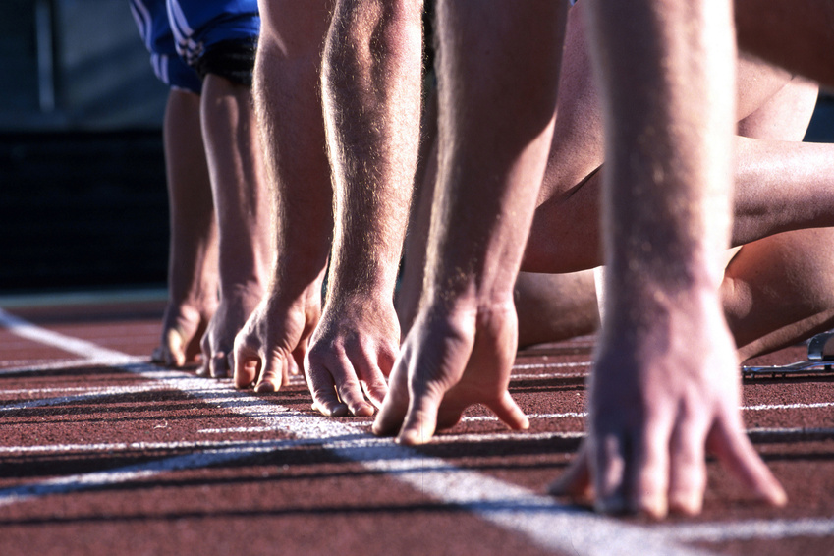
Are We Ready?

Slide 24

Questions & Discussion
Commitments
Tentative timeline
Who else should be invited:
  Core team
  Planning team
Next meeting date
Other discussion/questions

Slide 25
Contact Information
Building Disaster-Resilient Places

