Slide 1

Building Disaster-Resilient Places
STEP ONE – Forming a Collaborative Planning Team
Notes:
Welcome slide – have up when participants enter the room.
Welcome participants and allow time for introductions if participants are not already acquainted.
Warm up:
Ask each person to share the following information:
Name (If they are not already acquainted)
Occupation
The most recent disaster they can recall
One thing that went well in responding to the disaster
One thing that could have been better
Record the “went well” and “could have been better” responses on separate charts. After everyone has responded, ask for a volunteer to identify common themes on each sheet.

Slide 2
A Mini-Quiz
72 hours =
3 days
What is
minimum amount
of time
you should be prepared
to survive
on your own
in a disaster?
The first 3
is on me
Notes:
This tiny mini-quiz is designed to set the stage for the planning process. Many individuals may not be aware that FEMA recommends a minimum of 3 days’ supplies on hand to sustain you and your family.
The first mouse click will bring up the question. Get responses from the participants.
After hearing from a few people, show the answer (2nd mouse click.) Often the standard is stated in hours. The 3rd click of the mouse translates that into days.
The final click of the mouse gives an easy rhyme to help people internalize the recommendation: The first three (days) is on me.
The reality, though, is that for rural places involved in a large scale disaster that covers a lot of territory, three days may not be enough. The next slide continues this thought.

Slide 3
Rural Challenges
Harder to Plan
Longer to Receive Aid
Rural places seldom have dedicated staff support.
Emergency planners often wear multiple “hats.”
Remote locations are more difficult to reach.
Communication may be more difficult.
Help begins where the greatest number of people are impacted.
Notes:
Throughout a series of roundtable sessions with emergency managers, the challenges that rural emergency managers consistently noted are shown in this chart.
Harder to Plan: On the one hand, emergency managers found the planning process particularly challenging as many stated that they had no dedicated staff support and that they also wore many “hats” in the community, with emergency planning typically only a part of their job responsibilities.
Longer to Receive Aid:
The remoteness of the communities they served made responses to disasters more challenging. Less developed rural roads and the distance between homes meant response times were increased over more metropolitan areas.
Communication challenges were reported as fewer back-up systems tended to be available in these locations.
During widespread disasters (such as Katrina), outside assistance usually focuses first on the places where the most people are impacted.
These concerns along with others identified through the year-long roundtable process have led to the ReadyCommunity initiative, designed to respond to the challenges of rural communities in assessing risks and planning for disasters with the support of a local coach and national team.

Slide 4
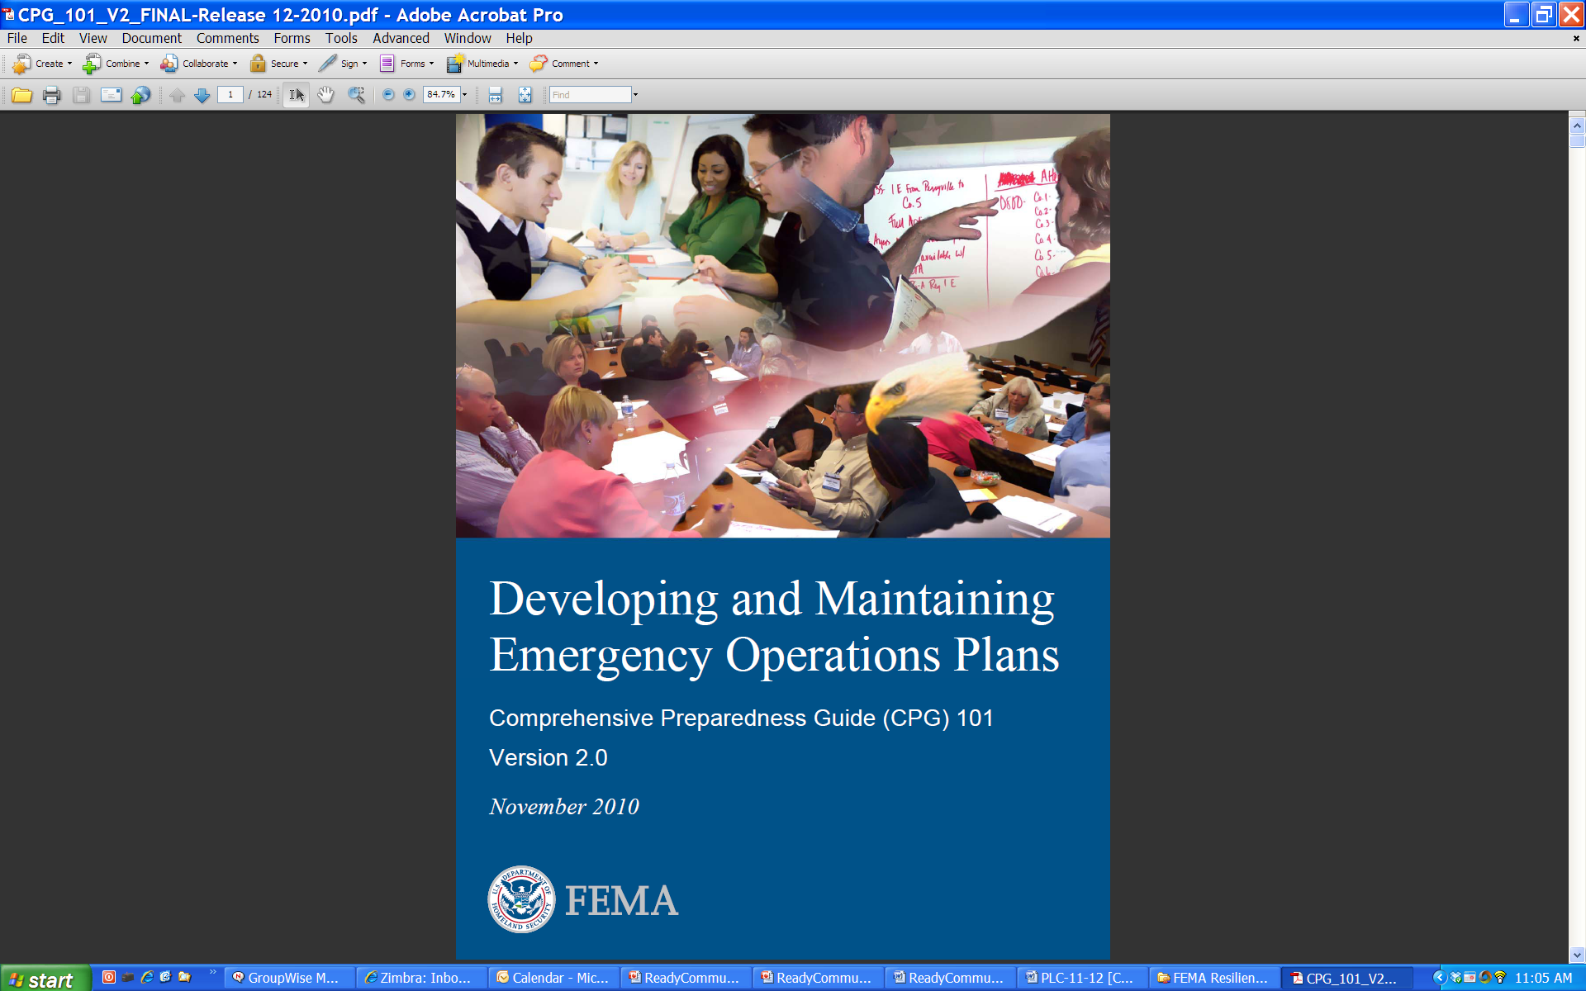
FEMA’s CPG 101
Comprehensive Preparedness Guide
Purpose of CPG 101:
  Conduct community-based planning that engages the whole community
  Ensure plans are developed through an analysis of risk
  Prioritize plans to support their seamless transition from development to execution
  Integrate and synchronize efforts across all levels of government
  Become compliant with FEMA’s guidelines for emergency preparedness
Notes:
ReadyCommunity is based on FEMA’s Comprehensive Preparedness Guide (CPG 101).
This guide is designed to provide a blueprint for successful planning. Its stated purposes are listed on this slide.
ReadyCommunity aids in this process by providing these supports to the process directly aligning with the CPG 101 guidance.

Slide 5
What is Involved?
Step 1: Form a Collaborative Planning Team
Step 2: Understand the Situation
Step 3: Determine Goals & Actions
Step 4: Plan Development
Step 5: Plan Preparation, Review, & Approval
Step 6: Plan Implementation & Maintenance
Step 1: Form a Collaborative Planning Team
Step 2: Understand the Situation
Step 3: Determine Goals & Actions
Step 4: Develop the Plan
Step 5: Prepare, Review, & Approve the Plan
Step 6: Implement & Maintain the Plan
Notes:
The process follows six basic steps as outlined in CPG 101 and shown here.
Today begins the journey with an exploration of Step One.
(Note that we substitute the word “actions” for “objectives” in Step Three, as it is a more commonly understood term.)

Slide 6
Layers of Involvement
Community
Planning Team
Core Team
Community Coach &
Emergency Manager
Notes:
The CPG 101 outlines three layers of involvement in the community planning process. Each layer has specific roles to play.

Slide 7
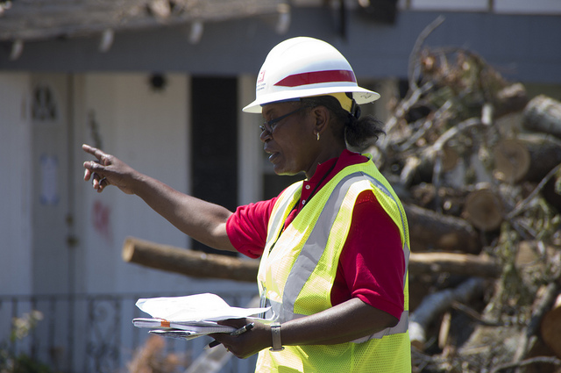
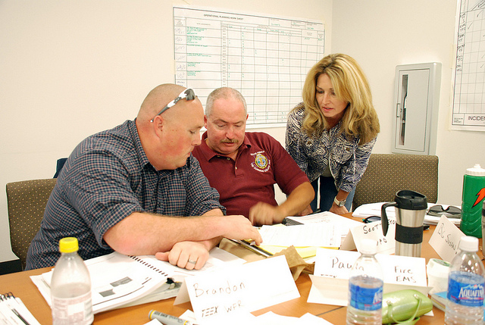
Purpose of the Emergency Manager
Has the legal responsibility for overseeing emergency preparedness and response
Taps supporting resources, most of which come through government avenues
Provides expert guidance for the plan
Ensures important connections between community, county, state, and federal plans
Notes:
This slide outlines the importance of the emergency manager’s role in the planning process. ReadyCommunity should not been undertaken without involving the person(s) with legal authority over disaster planning and response. Without the involvement of that person, the planning will likely have limited success.
Among the important roles that the Emergency Manager plays are:
Has the legal responsibility for overseeing emergency preparedness and response
Taps supporting resources, most of which come through government avenues
Provides expert guidance for the plan
Ensures important connections between community, county, state, and federal plans

Slide 8

Purpose of a Community Coach
Supports the planning effort, from start to finish
Helps organize the Core Team and Planning Team
Facilitates the process that aids the Team in preparing a plan
Helps coordinate community involvement
Provides links to data and expertise available through the partners
Notes:
A community coach, or facilitator, is here to help the community work through the planning process by using focused activities to help guide the group to the end goal.
Some of the specific ways a coach can assist are listed on the slide.
The Community Coach:
Supports the planning effort, from start to finish
Helps organize the Core Team and Planning Team
Facilitates the process that aids the Planning Team in preparing a plan
Helps coordinate community involvement
Provides links to data and expertise available through state, regional and/or national partners

Slide 9
Core Team Responsibilities
Guide the overall process
Recruit others
Commit to participating in sessions
Work as a team
Prepare Emergency Operation Plan
Community
Planning Team
Core Team
Notes:
The Core Team has key leadership in organizing the input from the various avenues.
This slide outlines their key responsibilities. These include:
Guide the overall process
Recruit others from the community to gain needed input and assistance
Commit to participating in planning sessions
Work as a team through the planning experiences
Prepare an Emergency Operation Plan aligned with the state emergency guidelines
Discussion: Who in this community/county are the ones that we would most like to include in this group?

Slide 10
Planning Team Responsibilities
Community
Planning Team
Core Team
Participate in planning sessions
Contribute to community assessments
Help involve community
Assist in designing the emergency plan
Commit to keeping the plan current
Notes:
In support of the Core Team, the Planning Team provides key assistance and support throughout the process.
Here are key roles that they play:
Participate in planning sessions
Contribute to community assessments
Help involve community
Assist in designing the emergency plan
Commit to keeping the plan current

Slide 11

Goals of the Planning and Core Team
Build and expand relationships
Bring creativity and innovation to planning
Define roles to be taken during a disaster
Understand roles and abilities of others
Establish a planning routine
Notes:
Goals of the Planning and Core Team
Working together, the Core Team and Planning Team will aim toward these five goals (see slide):
Build and expand relationships that may help strengthen the response efforts.
Bring creativity and innovation to the process. Different viewpoints and ideas can strengthen the planning process by providing a wider variety of options to consider.
Define roles to be taken during a disaster. When a disaster hits is not the time to try to figure out who’s who in the community. In order to respond efficiently and effectively, these roles should be planned well in advance.
Understand the roles and abilities of other organizations. Many challenges in a disaster can be avoided or lessened by a clear understanding of who can do what in the community. Often, false expectations lead to frustration, anger, and sometimes, even added risk and danger.
Establish a planning routine that aids in responding before, during, and after a disaster. With strong working relationships already built during the planning process, responding to a disaster in a unified manner becomes a much easier task.

Slide 12

Who Should Be at the Table?
Notes:
So, the next question is, “Who should be at the table for these planning sessions?”
Note to Facilitator:
This slide is a transition slide. Use slides 12-14 to lead a discussion on who else should be involved in the planning process and at what level (Core Team, Planning Team, community).
List responses on a flip chart as you discuss.

Slide 13
FEMA Suggests…
Who else
is missing?
Planning Team
Fire Services
Emergency Manager
Law Enforcement
Health Services
Utilities
Education
Social Services
Agriculture & Farming
Children’s Services
National Guard
Civic Organizations
Notes:
Here are the basic groups that FEMA suggests. Most communities will have someone that serves in each of these key community roles. The point is to have all key sectors that are needed to help coordinate a community-wide response joining in on the planning process. (Click to add, “Who else is missing?”)
Ask participants:
While this list is certainly a sound starting point, what other major sectors are present in your community?
Make sure these are included:
Business/industry
Non-profits
Faith-based organizations
Elected officials

Slide 14
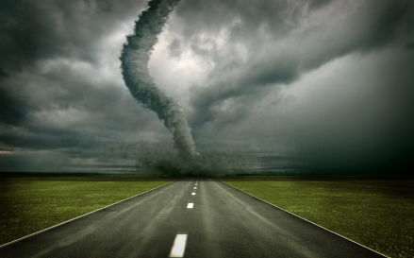
Considering Special Needs
What people or groups are most likely to have difficulty responding to a disaster in your community?
Notes:
In addition, think about those people in your community that may have the most difficulty responding to a disaster.
Ask participants:
What people or groups are most likely to have difficulty responding to a disaster in your community?
Who has contact with these people or groups on a regular basis? Be sure to list the answers on the flip chart.
Make sure they consider these groups along with any others they may identify:
Low income (bring employers of these to the planning table)
Families with small children, particularly single parent households
Non-English speaking
Home bound
Those without transportation
Medically dependent (dialysis, oxygen dependent, etc.)
Institutionalized individuals
Elderly
Individuals with disabilities
NOTE: Use these responses to expand on the “Who Is Missing” discussion on the previous chart. Also, save this list of special needs individuals as it is used in Step 2.

Slide 15
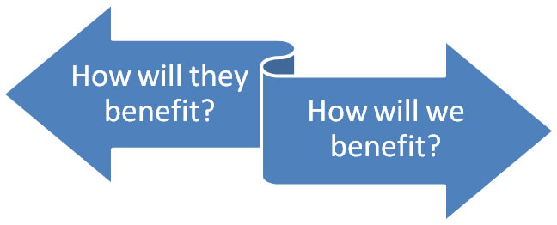
How to Involve Others in Planning
Disaster
Core Team
Community Organizations and Individuals
Creating a Win-Win Partnership
Notes:
Slide 19 shows how to create a “win-win” partnership that forms the foundation for getting others involved.
Using the flip chart list generated in the previous exercise and handout 3, have the group identify the elements of the win-win partnership.
For each person/group identified, determine what they would gain from participating in planning and what the planning team would gain from their participation.
If the group is large enough and/or the flip chart list is long, consider dividing the group to let them work on different parts of the list.
Debrief and get commitments. If you divided the group into smaller teams to work, have them each report back.
Then, either have a few volunteers role play an invitation to a potential partner on the list. OR divide the group into pairs and have each pair role play an invitation.
Once participants are able to walk through these steps, ask for volunteers to contact each of the identified potential partners to invite them to the next meeting. Record the volunteers’ names beside the individuals. Accountability is important throughout this process.

Slide 16
When to Involve the Community
Two Touch-Points in the Planning Process
Step 1: Form a Collaborative Planning Team
Step 2: Understand the Situation
Step 3: Determine Goals & Actions
Step 4: Plan Development
Step 5: Plan Preparation, Review, & Approval
Step 6: Plan Implementation & Maintenance
Verify and strengthen information gathered
Communicate the plan. Involve the community in staying ready
Notes:
The planning process suggests two community touch-points that can strengthen community disaster planning. Within Steps Two, and Six of the planning process, the community can play a significant role.
Step Two, Understanding the Situation, community members can verify and strengthen the assessments. They can also giving feedback on community mapping to ensure that these accurately reflect what is happening on the ground.
Step Six: Plan Implementation and Maintenance: This final event is an ideal time to educate the public on their how they can prepare as individuals or families as well as encourage volunteerism and training to promote a more sustainable community response network.
As we walk through those steps, we will talk about specific strategies that are effective in gaining input.

Slide 17
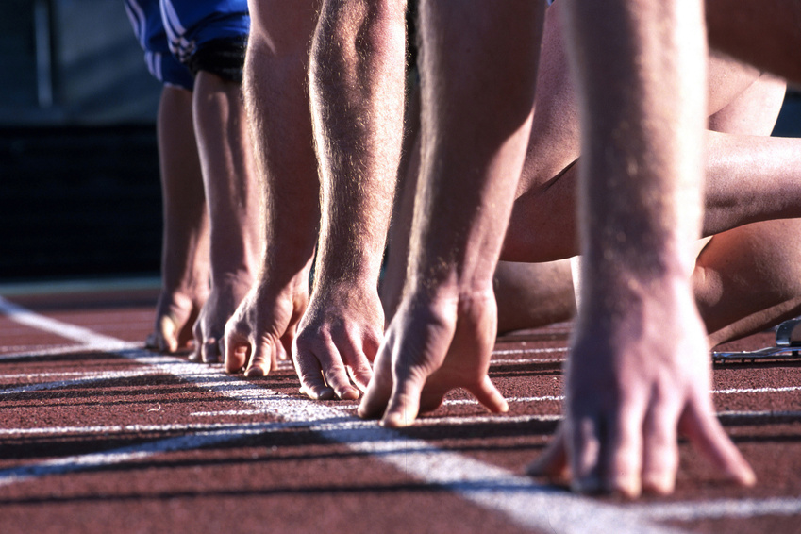
Are We Ready?
Notes:
This process is designed to help gauge how participants feel about the preparedness task at hand.
Ask participants to take a moment to complete the short worksheet “Are We Ready to Plan?”
Have them total their response numbers. Explain that they are to answer each question to the best of their own personal knowledge, Treat “I don’t know” as “no.”
Place the two signs “Ready” and “Not Ready” on opposite sides of the room (or some reasonable distance apart to allow participants to take a position between them based on their total scores). Have participants view the space between the two signs as a continuum with “Ready” being a maximum score of 70 and “Not Ready” being a score of 14.
Ask them to all come take a place along the continuum that best represents their total score.
Lead a discussion based on their positions. These questions may serve as guides:
What do you observe about the group spacing (Is everyone clustered together or scattered)?
What appears to be about the average “score” for readiness for the group?
How do you think a lack of information or connections may influence community readiness (reference the times people didn’t know the answer to various questions.)
Question for high scorers: What gives you the most hope that this project will be successful?
Questions for low scorers: What is your biggest concern?
What are some things we can do to raise the group’s readiness scores?

Slide 18

Questions & Discussion
Commitments
Tentative timeline
Who else should be invited:
  Core team
  Planning team
Next meeting date
Other discussion/questions
Notes:
This final content slide serves as a debrief for the session. These key concepts listed on the slide are potential starting points for the discussion. Some of the previous exercises may have led to some additional essential next steps to promote planning readiness.

Slide 19
Contact Information
Building Disaster-Resilient Places
Notes:
Thank participants for coming.
Note to Facilitator:
Be sure to include your contact information as well as the local point person’s contact information so that all participants can stay connected to the planning process.

