Slide 1
Notification and Orientation
Notes:
Instructions: Insert the details into the following slides including the addition of local sponsor logos as you see fit.
Have this slide up when participants enter the room. As you begin the session, acknowledge the partners and sponsors/local partners.
Time: 3 minutes
(2 hour presentation total)
Materials: None
Handouts: None

Slide 2
Acknowledgements
This curriculum was made possible through funding by Walmart. The findings, conclusions, and recommendations presented in this curriculum are those of the Southern Rural Development Center and its project partners alone, and do not necessarily reflect the opinions of Walmart.
This work is supported by 2022-51150-327212 from the U.S. Department of Agriculture, National Institute of Food and Agriculture.
Any opinions, findings, conclusions, or recommendations expressed in this publication are those of the author(s) and should not be construed to represent any official USDA or U.S. Government determination or policy.
Notes:
Instructions: Share this acknowledgment of the partnerships with CREATE BRIDGES.
Materials: None
Handouts: None
Time: 1 Minute

Slide 3
Notification & Orientation
Business Retention and Expansion
Resource Listing of businesses, training programs, and resources
New strategies
and
actions
Regional Steering Committee
CREATE
BRIDGES
Forum
CREATE
Academy
Employee engagement
Notes:
Instructions:
The purpose of the orientation session is to provide an overview of the CREATE BRIDGES process and what it aims to accomplish. Participants in the orientation session should include local stakeholders who will be involved in promoting and implementing the program. This could include Chambers of Commerce and Main Street directors, potential steering committee members, owners of anchor businesses, local leaders such as mayors and county commissioners, local educators, and representatives from organizations that support retail, accommodations, tourism and entertainment sectors.
This slide (highlighted in orange) shows where the Orientation takes place within the CREATE BRIDGES process.
These steps take place over a period of about 3 years. Depending on when and to whom this presentation will be given, you may wish to highlight which steps have been completed and where the region currently is in the process. Also, depending on the audience, you may want to provide a brief description of each step in the process. A description of each step can be found in the Introduction module.
Form a regional steering committee
Conduct a resource listing of CREATE businesses and existing trainings and resources
Host a CREATE BRIDGES Forum
Conduct Business Retention and Expansion surveys
Conduct employee engagement through surveys
Convene a CREATE Academy
Identify new strategies and actions
Time: 2 minutes
Materials: None
Handouts: CREATE BRIDGES Overview Handout

Slide 4
Introduction and Teambuilding
Source: https://weand.me/product/we-connect-cards/
Notes:
Instructions: Consider adding an icebreaker or team building activity during introductions. Team building activities, especially with the Regional Steering Committee are key to the program’s success.
We Connect Cards can be found through the website below. A printable partial deck is also available for free through the second link. The website and YouTube channel (https://www.youtube.com/weandme) contain several videos with ideas for using the cards.
It is not necessary to purchase these cards for team building, but they are a tool the pilot team has found helpful. You are also welcome to use other tools and methods for ice breakers and team building activities.
Full deck: https://weand.me/product/we-connect-cards/
Free printable sample: https://weand.me/tools/
Time: 8-10 minutes
Materials: We Connect cards or another teambuilding exercise
Handouts: None

Slide 5
Building your Regional Steering Committee
RSC
Economic Development
Education
Workforce Development
Others
Government
Non-profits
Businesses
Employees
Notes:
Instructions:
When selecting the steering committee members, include sectors from a broad mix of retail industry stakeholders. The steering committee should reflect the diversity of the region.
Consider individuals from:
Economic Development
Education
Workforce Development
Government
Non-profits
Business
And others that are appropriate for your region
Also consider race, ethnicity, and gender in composition
Time: 1-2 minutes
Materials: None
Handouts: None

Slide 6
Regional Steering Committee Responsibilities
Coordinate with state facilitators
Guide resource listing assignment
Engage key stakeholders and the public
Plan and implement communications strategy for region
Initiate CREATE BRIDGES Forum
Survey businesses and employees
Participate in CREATE Academy
Coordinate support for existing CREATE businesses
Implement new strategies and actions
Notes:
Instructions:
These are the responsibilities of the regional steering committee in roughly chronological order. Some of these tasks will be performed by a subset of the committee while others will be performed as a whole. Resources are available to complete these tasks!
Time: 1 minute
Materials: None
Handouts: None

Slide 7
Orientation Agenda
Introduce CREATE BRIDGES Program​
CREATE BRIDGES Forum Planning​
Introduce Business Retention and Expansion Options​
Introduce Employee Engagement Survey
Resource Listing Exercise ​
Notes:
Instructions: This slide lists the agenda of the Orientation. The Orientation is designed to give an overview of the CREATE BRIDGES process that will inform the strategic planning and workforce development phases.
Time: 1 minute
Materials: None
Handouts: None

Slide 8
What is a Resource Listing
Identifying and providing information on the regional CREATE BRIDGES resources and assets
This Photo by Unknown Author is licensed under CC BY
Notes:
Instructions:
This activity will begin at the Orientation workshop and continue through the Forum.
Taking time to identify resources and assets before setting goals in the regions is important because having a good understanding of the breadth of resources available in the region can be a valuable way to determine which opportunities should be pursued as regional goals and which ones should be put on the back burner as priorities given that the required assets are simply not in place. Opportunities where the resources needed are already available may be easier to launch. On the other hand, goals that require absent or underdeveloped assets will require more preparation time and effort for the goals to be successful.
Alternative Definition:
A process by which local assets are considered “the primary building blocks of sustainable community development. Building on the skills of local residents, the power of local associations, and the supportive functions of local institutions, asset-based community development draws upon existing community strengths to build stronger, more sustainable communities for the future.”
--ABCD Institute
Time: 2-3 minutes
Materials: Flip charts, markers
Handouts: Resource Listing Form

Slide 9
Purpose
Strengths
Provides a picture of the region’s strengths as they relate to CREATE sectors
Invitation
Provides a potential invitation list for the CREATE BRIDGES forum
Foundation
Provides a foundation for BR&E and workforce training phases
Notes:
Instructions:
The resource listing serves three basic purposes.
It provides a picture of the region’s strengths as they relate to the CREATE sectors.
It provides a potential invitation list for the CREATE BRIDGES forum.
It provides a foundation for the BR&E and workforce training phases.
While this list will be initiated at the Orientation, the Regional Steering Committee can continue to add to it as needed and it will be expanded upon at the CREATE BRIDGES Forum event
Time: 2-3 minutes
Materials: Flip charts, markers
Handouts: Resource Listing form

Slide 10
How to Conduct a Resource Listing
Make a list of CREATE businesses and workforce development organizations in your region
Expand the list to include other assets that may be helpful using template provided
Finalize and share the template
Notes:
Instructions:
Resource listing is a process by which community strengths and resources are inventoried and placed into a framework to help understand their role in the community and potential role in furthering development.
Resources include People, Volunteer Associations, Formal Institutions, and Physical Resources
Resource listing process:
Catalogue a list of CREATE businesses and workforce development organizations.
Expand that list to other assets that support CREATE sectors (e.g. natural resources, cultural events, traditions, government)
Plot these identified assets on the provided Resource Listing Forms.
Our goal is to develop a detailed picture of the region’s strengths for developing CREATE businesses and workforce.
To conduct the Resource Listing exercise, have participants list resources on large flip chart pages, according to categories. Information provided on these pages can be as simple as the name and location. These flip chart pages can be stationed around the room and participants can walk between lists. The Resource Listing form can be used as a guide or you can provide a handout of Slide 10. For this exercise, focus on the resources for businesses and workforce as well as regional assets—the businesses themselves can be listed separately.
Time: 3-5 minutes
Materials: Flip charts, markers
Handouts: Resource Listing Form

Slide 11
Examples of Community Resources
Individual capacities – community members, Extension staff, faith leaders, community volunteers
Formal and informal community associations – volunteer organizations, faith-based groups, training and workforce organizations
Community institutions – universities, colleges, k-12 schools, not-for-profits, businesses, banks and lenders
Physical assets – parks, infrastructure, transportation
Community leaders and developers – current and potential local leaders and policy makers
Notes:
Instructions:
Here are some examples of community resources to help fill out your resource listing form. Be sure to expand upon the resources available—grants the region is eligible for, resources in region not yet utilized, trainings that could be implemented, partnerships, etc.
Time: 10 minutes
Materials: Flip charts, markers
Handouts: Resource Listing Form

Slide 12
Resource Listing Form
Name of Organization/ Resource | Name of Contact | Service Area (region, county, town) | Location | Type of Resources | How could this resource support CREATE BRIDGES?
Example: Innovation Hub | Sally Scheringer | Creek County | Greenville | Community Resource | Provides start up support
Example: Harris Community College | Cindy Davis | Tri-County Area | Sparksville | Community Institution | Offers academic and vocational training
Notes:
Instructions:
Here is an example using the provided template. You can also refer to the Resource Listing Form handout.
Any resource should fit into one of the 5 categories listed on the previous slide, and some will fit into more than one category.
Use this template to create your resource list as you go. You can return to the previous slide as a reference for the “examples of community resources” during the activity.
For organizational purposes, it is probably easier to split the list into two parts—one with resources for businesses, workforce members, and the project, and one listing all the CREATE sector businesses. This slide shows an example of the list of resources.
Time: 1-2 minutes
Materials: Flip charts, markers
Handouts: Resource Listing Form

Slide 13
Resource Listing of Businesses
Name of Business | Name of Business Owner | Contact Information | Location | CREATE Sector
Example: Annabelle’s Boutique | Sally Scheringer | (111) 111-1111 SallyS@place.com | 401 Main St., Greenville | Retail
Notes:
Instructions: The process is very similar for businesses, except for businesses, you should list the CREATE sector that business belongs to.
This business listing is part of the larger Resource Listing but it’s helpful to list them separately since this list will be used as a starting point for engaging with all the businesses in the region.
For this list, you should attempt to list all the CREATE sector businesses in the region. If there are existing resources that provide a starting point, use those as you’re able and update the information.
Time: 1-2 minutes
Materials: Flip charts, markers
Handouts: Business Listing Form

Slide 14
Anything Missing? Complete Version by [target date]
Notes:
Instructions:
Once your forms are complete, take a look, discuss, and see if anything is missing. Is there anything else that could be an asset to workforce development that is not on the list? Discuss your list with the RSC to check for thoroughness.
The Regional Steering Committee will then input the flip chart page information into the official Resource Listing Form, adding name of contact, service area, type of resource and how it can be used to support the CREATE BRIDGES initiative.
Next, select a target date for the complete version.
Time: 5 minutes
Materials: None
Handouts: None

Slide 15
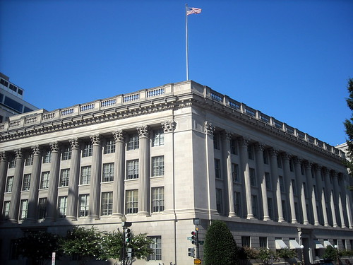
CREATE BRIDGES Forum
An opportunity to create buy-in within your region
This Photo by Unknown Author is licensed under CC BY-ND
This Photo by Unknown Author is licensed under CC BY-SA-NC
This Photo by Unknown Author is licensed under CC BY-SA-NC
This Photo by Unknown Author is licensed under CC BY-NC
Notes:
Instructions:
The second public event of the CREATE BRIDGES process is the CREATE BRIDGES Forum.
The forum is an opportunity to create buy-in within your community.
Suggested invitation list includes (but not limited to):
Industry and financial leaders
Representatives of faith-based organizations
Entrepreneurs/small business leaders
County Extension Service personnel
State and federal Congressional representatives or staff
Local and regional government representatives
Minority and women-owned business owners
Chamber of Commerce, economic development, and/or tourism organizations
Workforce Development Board representatives from the area
Educational leaders and organizations
Nonprofit, voluntary and civic-minded organizations
Community foundations
Rural cooperatives
Consider, too, how to reach multi-generations, different ethnic and racial groups, varying socio-economic sectors.
Time: 3-5 minutes
Materials: None
Handouts: None

Slide 16
Forum Agenda
At the forum, participants will:
Learn about the CREATE BRIDGES process
Add to resource listing form
Conduct group work to identify strengths, challenges, and priorities
This Photo by Unknown Author is licensed under CC BY
Notes:
Instructions: Briefly share the forum agenda as outlined in this slide.
Time: 3 minutes
Materials: None
Handouts: None

Slide 17
CREATE BRIDGES Forum Planning
When
Where
Who
How
Notes:
Instructions:
As a group, determine best date for forum within 2 months and where it should be held. Nail down a target number of attendees and who should be there. Then work together to determine the best way to invite these attendees. Keep the resource listing in mind and set out how additions to the list will be invited. Be sure each invitee is matched with an RSC member who will invite the person/organization to the forum.
If there is difficulty finding time together, narrow down to 4 dates and times and follow up with a Doodle Poll to confirm which are best in communities..
Encourage attendees to check their calendars to avoid other events or major conflicts.
Time: 10 minutes
Materials: Pens, scratch paper
Handouts: None

Slide 18
The CREATE BRIDGES Process: A two-part approach, an overview
Strengthening CREATE Sectors
Business
Workforce
Notes:
Instructions:
The CREATE BRIDGES initiative will take a two-part approach to development. One portion of the program will focus on business development while the other will focus on workforce development.
Our goal is for these two approaches to work together to strengthen the CREATE sectors in the region.
The next two slides will outline the main data collection methods for both businesses and their workforce.
This program uses two main survey tools: the Business Retention & Expansion survey for businesses and a companion survey, the Employee Perspectives survey. The next two slides will outline those survey efforts.
Time: 10 minutes
Materials: None
Handouts: None

Slide 19
Business Retention and Expansion
Traditional Model with Volunteers
Traditional Model with Dedicated Staff
Roundtables and Focus Groups
Community Surveys
Notes:
Instructions:
This slides outlines the various methods for conducting a Business Retention & Expansion program as outlined in the curriculum. An entire chapter is dedicated to this process.
The information below is a long-form explanation of the survey styles. The explanations can be edited down for the purpose of introducing the concept and styles of BR&E survey efforts. There are multiple options for completing the surveys. In upcoming months, Regional Steering Committee members and state leads will discuss the options and decide what fits best for the region.
University of Minnesota Traditional Model The traditional BR&E model is conducted in three phases: Research, Prioritize and Implement. It utilizes a task force which trains volunteers to visit local businesses and conduct the BR&E quantitative survey. Once surveys have been completed, the data is tabulated and reviewed by the task force (while also looking for “warning flags”). This group will use the data to design priority projects and write a research report summary. In the implementation phase, the task force will work on project teams to carry out the priority projects, convening quarterly for updates and evaluation of results. At the end of the process, the results are shared more broadly with the community.
The traditional model has shown to be effective in small to medium-sized communities, but could be difficult to implement “regionally”, given the reliance on a volunteer base to conduct surveys and the time constraints of the grant.
University of Minnesota Model with Paid Staff and “Volunteers” In this variation, the UNM model will utilize paid staff to interview the included businesses. The CREATE BRIDGES RSC would serve as the Leadership Team. Based on the resource listing assignment, they will identify the businesses that will be visited and interviewed throughout the entire region. Paid staff of 3-7 people will coordinate and visit the selected businesses, including extension staff, and fill out the BR&E form with the owners or managers. Data collection training could be centralized and occur once at the beginning of the data collection period. The short BR&E form would be used as it requires less than an hour, cutting down labor costs.
While this variation would guarantee the systematic collection of consistent information and lead to a higher volume of data collected, it could be cost prohibitive.
Roundtables and Focus Groups - University of Kentucky Variation The University of Kentucky variation creates a unique twist on the traditional model. In this variation, communities will host an educational workshop (often during a lunch or breakfast meeting) that will also serve as the BR&E launch. As opposed to finding, training, and scheduling BR&E volunteers, CREATE BRIDGES staff will work with local stakeholders to identify and invite BR&E participants to the workshop where CREATE BRIDGES staff will then conduct the event and implement the first round of BR&E surveys that are filled out on-site.
This model builds a large number of responses quickly, and then provides a launch pad for further BR&E efforts through a traditional model using local economic developers. BR&E
Community Survey This variation focuses on data collection through survey distribution. This could be done with both the short and long form of the UMN model. An online version and a paper version would be available. The link would be distributed by RSC and other volunteers for targeted participants to fill out. In addition, a paper survey would be mailed to the list of resources created by the RSC. These surveys could led to follow-up in-person meetings by the RSC and/or project staff. The web platform Qualtrics would be the easiest for the online survey as it is already available by all partner states. This model would allow for larger distribution, however, it would likely have a lower collection rate. Access to consistent internet access or a mobile phone would be required which might be limiting in the CB regions. The paper version would require some data entry work.
Time: 5-7 minutes
Materials: None
Handouts: None

Slide 20
Employee Perspectives
This Photo by Unknown Author is licensed under CC BY-NC-ND
Notes:
Instructions: The BR&E survey has a companion survey for employees—the Employee Perspectives survey. We are interested in learning what barriers and opportunities employees in these sectors face. This information will inform strategies for workforce/employee development programs.
What’s the best way for this region to gain this information from the employees? How do we provide a space for them to be able to engage without fear of retribution and allow to share freely?
In the pilot regions, this was done through confidential, online surveys, but this region may wish to gather the information through other methods.
Time: 10 minutes
Materials: None
Handouts: None

Slide 21
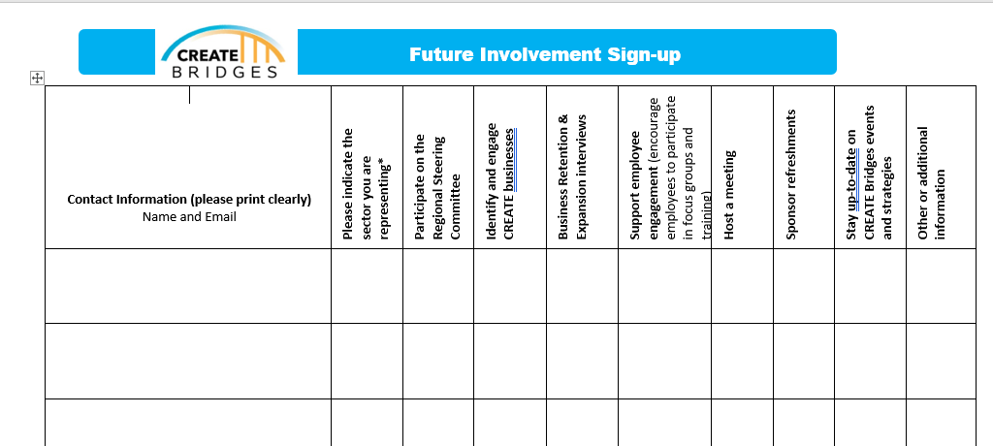
Get involved and stay in touch!
Notes:
Beginning during the Orientation workshop, include a Future Involvement form at each table or at the sign in table. This will allow participants to share contact information and indicate how they plan to be involved in the process. This form can be used during the Orientation workshop and the Forum workshop. If your state develops a website or landing page for the CREATE BRIDGES program, consider including a digital form using Qualtircs, Survey Monkey or Google Forms.

Slide 22
Questions?
Notes:
Instructions: Allow time at the end of the Orientation for questions and further discussion.
Time: 5 minutes
Materials: None
Handouts: None

