Slide 1
Welcome!

Slide 2
What is CyberSecurity
Cybersecurity is the art of protecting networks, devices, and data from unauthorized access or criminal use and the practice of ensuring confidentiality, integrity, and availability of information.
Network Security
Software Security
Information Security
This Photo by Unknown Author is licensed under CC BY-SA-NC

Slide 3
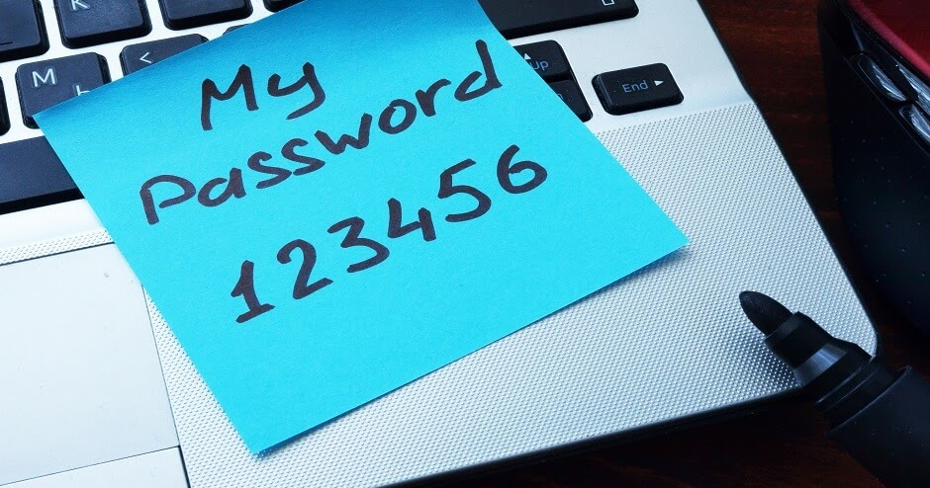
Top Ten Password
123456
123456789
Qwerty
Password
12345
Qwerty123
1q2w3e
12345678
111111
1234567890
This Photo by Unknown Author is licensed under CC BY-SA-NC

Slide 4
Password Safety Activity: How Safe is Your Password?
This Photo by Unknown Author is licensed under CC BY-NC-ND
https://www.security.org/how-secure-is-my-password/
Notes:
Use the link on the slide to demonstrate how quickly different passwords can be cracked. Start with one of the top ten passwords. Then ask the participants to help you build a good password. CAUTION: Do not allow people to share their real passwords in this activity.

Slide 5
Password Security Checklist
Never use personal information
Include a combination of letters, numbers, and symbols
Prioritize password length
Never repeat passwords
Avoid using real words

Slide 6
Impact of Stolen Passwords
Individuals:
4 out of 10 people have had their data compromised online.
Over 240,000 phishing scam complaints reported to the FBI in 2020.
80% of data breaches involving hacking passwords.
63% of consumers fear their identity will be stolen.
Businesses:
On average, it takes 280 days to identify and contain a data breach.
59% of U.S. consumers are likely to avoid businesses that have been a cyberattack victim within the past year.
57% of all companies have experienced a mobile phishing incident.
68% of business leaders feel their risk of a cyberattack is increasing.
This Photo by Unknown Author is licensed under CC BY
Notes:
Individuals and stolen password consequences:
4 out of 10 people have had their data compromised online. (Google, 2019)
There were over 240,00 phishing scam complaints reported in 2020. (FBI, 2020)
80 percent of data breaches involving hacking are connected to passwords. (Verizon, 2020)
63 percent of consumers fear their identity will be stolen. (Norton, 2021)
Businesses and stolen password consequences:
Across all industries, it took 280 days on average to identify and contain a data breach. (IBM, 2020)
59 percent of U.S. consumers are likely to avoid businesses that have become a victim of a cyberattack within the past year. (Arcserve, 2020)
57 percent of all companies have experienced a mobile phishing incident. (Wandera, 2020)
68 percent of business leaders feel their risk of experiencing a cyberattack is increasing. (Accenture, 2019)

Slide 7
Social Engineering
Social engineering is a manipulation technique that exploits human error to gain private information, access, or valuables.

Slide 8
Baiting
Baiting is a form of social engineering where an attacker actively or passively takes advantage of a person's greed or curiosity by promising some sort of incentive.
This Photo by Unknown Author is licensed under CC BY-SA

Slide 9
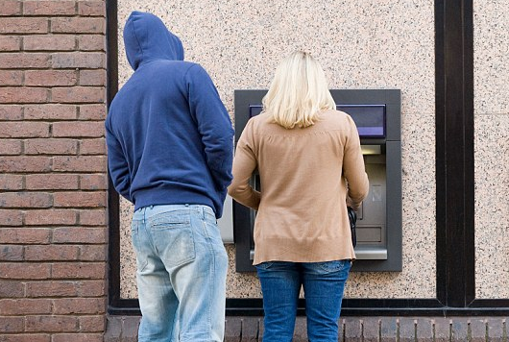
Tailgating and Shoulder Surfing
Tailgating, when it comes to social engineering, is when a person gains unauthorized access to an area that requires authorization by using deceptive tactics.
Shoulder surfing occurs when a person attempts to gather confidential information by simply looking over your shoulder.

Slide 10
Social Engineering Quiz
What is the best way to avoid shoulder surfing?
Using encryption when you send emails
Requiring identification before allowing access into a secure area
Maintaining awareness of your surroundings
Ensuring you know all the employees in your building

Slide 11
Social Engineering Quiz
What is the best way to avoid shoulder surfing?
Using encryption when you send emails
Requiring identification before allowing access into a secure area
Maintaining awareness of your surroundings
Ensuring you know all the employees in your building

Slide 12
Social Engineering Quiz: Baiting
Raza receives an email from someone claiming to be her mother's neighbor, asking her to help financially with a medical emergency.
Juan receives several phone messages from a credit card company, asking him to provide his username and password because of a security issue.
Jean receives an offer for a special price on a TV, but when she tries to order it she is told that only a more expensive one is available.
Moe clicks on an advertisement to play an online game for free, but when he opens the game he finds that it is malware.
Notes:
Which attack scenario is the best example of baiting?
Raza receives an email from someone claiming to be her mother's neighbor, asking her to help financially with a medical emergency.
Juan receives several phone messages from a credit card company, asking him to provide his username and password because of a security issue.
Jean receives an offer for a special price on a TV, but when she tries to order it she is told that only a more expensive one is available.
Moe clicks on an advertisement to play an online game for free, but when he opens the game he finds that it is malware.

Slide 13
Social Engineering Quiz: Baiting
Raza receives an email from someone claiming to be her mother's neighbor, asking her to help financially with a medical emergency.
Juan receives several phone messages from a credit card company, asking him to provide his username and password because of a security issue.
Jean receives an offer for a special price on a TV, but when she tries to order it she is told that only a more expensive one is available.
Moe clicks on an advertisement to play an online game for free, but when he opens the game he finds that it is malware.
Notes:
Which attack scenario is the best example of baiting?
Raza receives an email from someone claiming to be her mother's neighbor, asking her to help financially with a medical emergency.
Juan receives several phone messages from a credit card company, asking him to provide his username and password because of a security issue.
Jean receives an offer for a special price on a TV, but when she tries to order it, she is told that only a more expensive one is available.
Moe clicks on an advertisement to play an online game for free, but when he opens the game, he finds that it is malware.

Slide 14
Phishing, Smishing, and Vishing
Phishing
Smishing
Vishing
From: Someone purporting to be from a reputable company
Purpose: Get you to reveal personal information
(passwords, credit card numbers, bank details, etc.
Notes:
Phishing: The fraudulent practice of sending emails purporting to be from reputable companies in order to induce individuals to reveal personal information, such as passwords and credit card numbers.
Vishing: The fraudulent practice of making phone calls or leaving voice messages purporting to be from reputable companies in order to induce individuals to reveal personal information, such as bank details and credit card numbers.
Smishing: The fraudulent practice of sending text messages purporting to be from reputable companies in order to induce individuals to reveal personal information, such as passwords or credit card numbers.

Slide 15
Social Media Phishing/Catfishing/Catphishing
Phishing
An attack through social media
To steal personal data or gain control of your social media account
Catfishing
Person creates a fictional online persona to lure someone into a relationship—usually a romantic one
Catphishing
To get money, gifts, or attention.
Gaining rapport to access information and/or resources that the unknowing target has rights to.
Person creates a fictional online persona to lure someone into a relationship—usually a romantic one
Term
How It Looks
Purpose
Notes:
Social media phishing refers to an attack executed through platforms like Instagram, LinkedIn, Facebook, or Twitter. The purpose of such an attack is to steal personal data or gain control of your social media account.
Catfishing (spelled with an “f”) is a kind of online deception wherein a person creates a presence in social networks as a sock puppet or a fictional online persona for the purpose of luring someone into a relationship—usually a romantic one—in order to get money, gifts, or attention.
Catphishing (spelled with a “ph”) is similar, but with the intent of gaining rapport and (consequently) access to information and/or resources that the unknowing target has rights to.

Slide 16
Spear Phishing
Spear phishing is a phishing method that targets specific individuals or groups within an organization. It is a potent variant of phishing, a malicious tactic which uses emails, social media, instant messaging, and other platforms to get users to divulge personal information or perform actions that cause network compromise, data loss, or financial loss.
This Photo by Unknown Author is licensed under CC BY-NC-ND

Slide 17
Spear Phishing Example
Notes:
- [Instructor] Sending out a bunch of emails to people at random may work, but generic emails don't always catch a target. To increase the potential payout of a phishing attack and increase the success rate, it literally pays to be a lot more specific. Some attacks will target a specific organization or department or a specific employee within an organization. This is called spear phishing. If the targeted employee is a senior level employee, it's called whaling. Get it, because they'd be going after the big fish. So why get specific in who you're targeting? Like I said, the more time and energy put into these attacks, the bigger the potential payout. If an attacker sends an email to Lucy, a college student without much disposable income, they could threaten her until they're blue in the face. She's limited in resources so the attack could be successful, but the payout isn't necessarily guaranteed. If they target the CFO of an organization or the head of the finance department, a successful attack becomes way more lucrative. All it requires is a little bit more energy and more effort in the way the attack looks. Like a cover letter, spear phishing attacks are meant to be geared towards the target audience. So an attacker would typically spend some time developing a good pretext to base their attack on. Pretext is a story that a victim would be susceptible to. Social engineers, good and bad, create pretext by researching the victim before interacting with them. To develop a great pretext, a social engineer would take advantage of open-source intelligence, or OSINT for short. OSINT is any bit of information available to a person on the internet. Social media can fall into this posts on forums, pictures, online articles, anything that can be Googled is up for grabs. Once a pretext has been established, a social engineer can use the information to create a convincing phishing attack. This looks like a couple of things. It could be an email that appears to be from someone close to the target, like the target's boss or a leader in the target's organization. In my time as a security analyst, I saw multiple examples of this. I remember one particular time, an email was sent to the secretary of one of the directors of the company I was working for. The first email simply read, "Hey, are you available?" and was made to look like it was from the CEO. After a couple of exchanges back and forth, the CEO asked for 200 iTunes gift cards to be purchased and for the codes to be sent to them. The only thing that stopped that attack from being successful was the fact that it had happened before. CEOs are commonly impersonated when it comes to phishing attacks. This is because of the authority that they tend to carry. In some traditional company cultures, questioning the head honcho is something that rarely happens. If the CEO asks if you're available and asks you to do something out of the ordinary, you're more likely to comply. Another example of what a spear phishing attack can look like is a call from someone you may be familiar with, but don't know. In the video on vishing, I covered how a social engineer impersonated someone that I could confirm was important, but I had no way of authenticating their identity, or so he thought. His pretext needed a lot more work. Pretext could also come in the form of a person on social media who's requesting to be added to your network. If they're connected to anyone you know, there's a bit of intrinsic trust that could be available to a social engineer. A good way to combat spear phishing and whaling is to pay attention. Keep track of the normal ways that people get in touch with you and how they communicate. If you've never communicated with your boss via email and you get a suspicious email from your boss, try confirming the information through your normal means of communication.

Slide 18
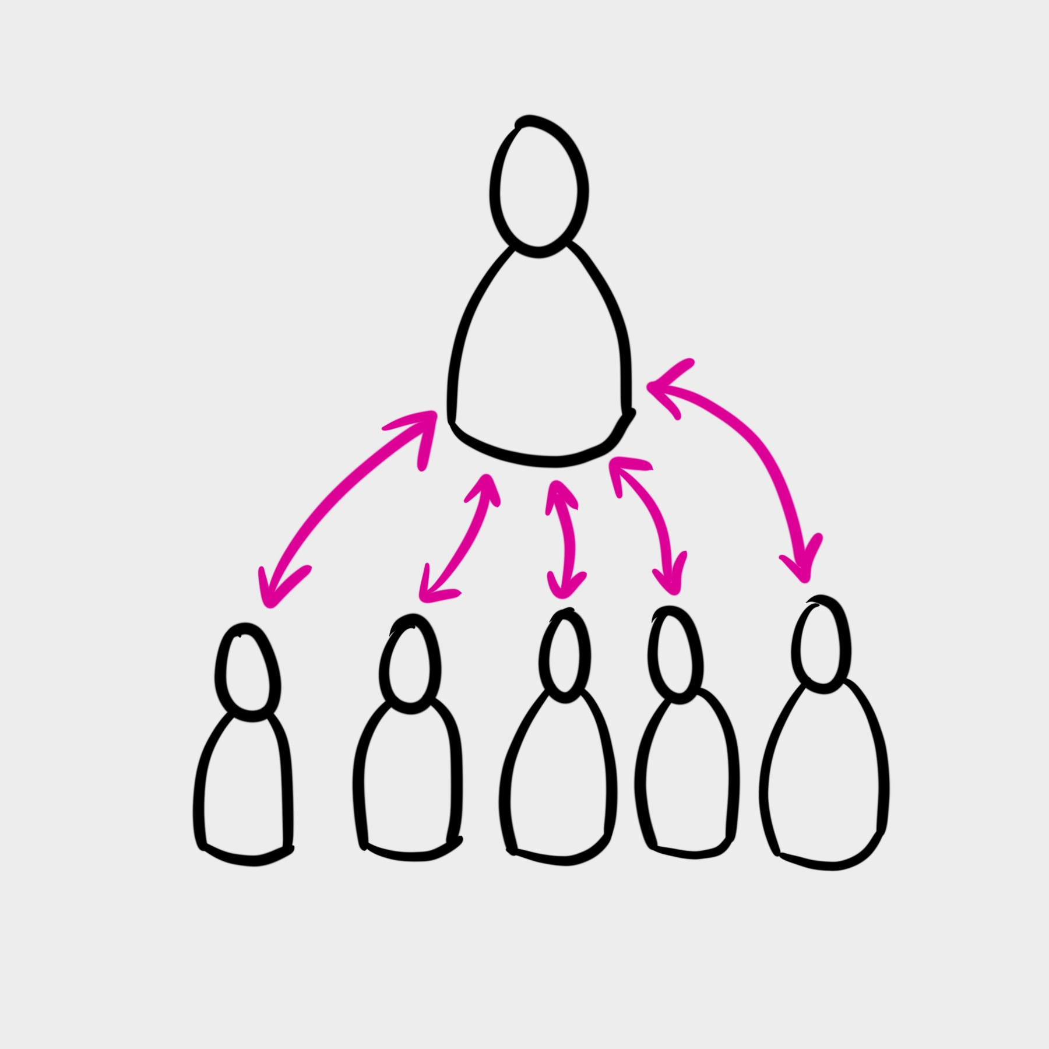
Whaling Attack or CEO Fraud
How it looks: cybercriminal masquerades as a senior player at an organization
Targets: senior or other important individuals at an organization, to trick a target into performing specific actions, such as revealing sensitive data or transferring money.
Purpose: stealing money or sensitive information or gaining access to their computer systems for criminal purposes.
This Photo by Unknown Author is licensed under CC BY-NC
Notes:
A method used by cybercriminals to masquerade as a senior player at an organization and directly target senior or other important individuals at an organization, with the aim of stealing money or sensitive information or gaining access to their computer systems for criminal purposes. Also known as CEO fraud, whaling is similar to phishing in that it uses methods such as email and website spoofing to trick a target into performing specific actions, such as revealing sensitive data or transferring money.

Slide 19
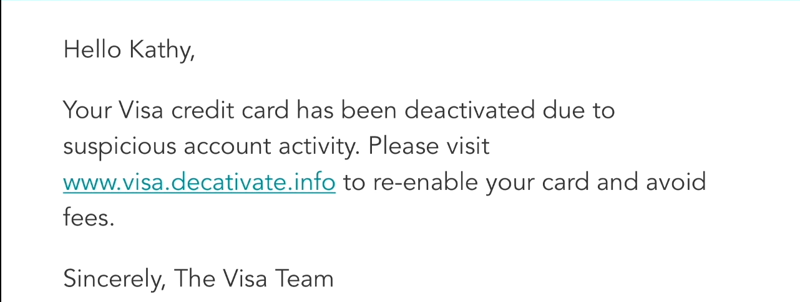
Phishing Attack Example 1
Notes:
Now let's do a quick aside and look straight at the link, which is in a different color than the rest of the text. What is the domain, is it Visa? Does it have anything to do with Visa? No. One must look at the link from right to left, and understand that the first dots and the two strings to its left and right, in this case decativate.info, comprise the domain name. Moving farther to the left, there is a .visa, which is a host or subdomain. And even farther to the left is www, which is another host. So the actual domain is decativate.info, which is bogus. It has not been registered and it's only being used for example purposes. Some people see www.visa and think that it's a legitimate site, because they don't understand the structure of domain names. Do you notice any typos, and would you expect to? Today's phishing emails are much different than phishing emails from the past. Often the verbiage is very professional, but that depends on the authors, the intent, and the type of phishing attack. Intent can range from getting the victim to browse to a site, to getting the victim to input credentials, to wanting the victim to open an attached file. It all depends on what the creators are trying to accomplish. You might be surprised how many people click on that link. So what is the intent, and why would the attackers want someone to click on the link? To answer those questions, we would have to research the email a bit more; look at the headers, check if there's an attachment, and research the who-is record. Let's focus on the who-is record for a moment. Who-is records are records that are associated with the domain or IP address of a website or network, respectively. The record contains information such as when the domain or network was first registered, who the points of contact are for the domain, and often times, it even provides a means to contact the owners of the domain or network. Now think about phishing more generally speaking. If phishing is so prevalent, and so many people fall victim to these type of attacks, how come we just don't stop it from happening? What do you think it would take to stop phishing attacks from being successful?
This is what the attackers are hoping for. In the past, phishing emails came in the form of a desperate Nigerian prince that needed assistance to claim his inheritance or a chain letter email that stated dire consequences if not forwarded. No matter the way the message looks, and no matter what the message says, the end goal is always similar. Getting someone to take an action they wouldn't normally take. This action will be in favor of the attacker, mostly resulting in some form of financial gain or private information acquisition. An example of an action that could be taken because of a phishing email is putting your credentials into a form on a fake website that looks like a legitimate one. When this happens, you may get an error that your password doesn't work or you may be taken to a blank page, not knowing that your credentials were taken. Another example of an action that can be taken is clicking

Slide 20
Phishing Attack Quiz
You see a phishing attack occur against a high-level employee in your company. What category of phishing attack is this?
A smishing attack
A spear-phishing attack
A whaling attack

Slide 21
Phishing Attack Quiz
You see a phishing attack occur against a high-level employee in your company. What category of phishing attack is this?
A smishing attack
A spear-phishing attack
A whaling attack

Slide 22
Social Engineering Quiz
How does vishing differ from other phishing attacks?
It involves repeated attacks.
It involves software updates.
It occurs over the telephone.
It occurs by emails.

Slide 23
Social Engineering Quiz
How does vishing differ from other phishing attacks?
It involves repeated attacks.
It involves software updates.
It occurs over the telephone.
It occurs by emails.

Slide 24
Social Engineering Quiz
Who are targets of whaling attacks?
Upper executives or those with sensitive information
Human resources personnel
Administrative assistants
All employees

Slide 25
Social Engineering Quiz
Who are targets of whaling attacks?
Upper executives or those with sensitive information
Human resources personnel
Administrative assistants
All employees*
*Typically, these target upper executives or those with sensitive information, though “all employees” could be true, especially in a small organization.
Notes:
Typically, these target upper executives or those with sensitive information, though “all employees” could be true, especially in a small organization.

Slide 26
Phishing Attack Quiz
Which type of phishing attack comes via SMS (text message)?
Smishing
Vishing
Evil twin

Slide 27
Phishing Attack Quiz
Which type of phishing attack comes via SMS (text message)?
Smishing
Vishing
Evil twin

Slide 28
Phishing Attack Quiz
What type of call is almost always a vishing attack?
A call from someone stating they are with a government agency
Any call made from a phone number that an individual does not recognize
A robocall made to someone's personal cell phone number

Slide 29
Phishing Attack Quiz
What type of call is almost always a vishing attack?
A call from someone stating they are with a government agency
Any call made from a phone number that an individual does not recognize
A robocall made to someone's personal cell phone number

Slide 30
Phishing Attack Quiz
Many people have detailed profiles of themselves and their family members on social media sites. How are they vulnerable to phishing attacks?
Many people use family members' names as the answers to security questions on websites, such as their banks.
The information on profiles can lead phishing attackers to the individuals' bank accounts and credit card information.
The more contacts individuals have, the more likely the technologically sophisticated phishing attackers will target them.

Slide 31
Phishing Attack Quiz
Many people have detailed profiles of themselves and their family members on social media sites. How are they vulnerable to phishing attacks?
Many people use family members' names as the answers to security questions on websites, such as their banks.
The information on profiles can lead phishing attackers to the individuals' bank accounts and credit card information.
The more contacts individuals have, the more likely the technologically sophisticated phishing attackers will target them.

Slide 32
Acknowledgement
This material was developed by members of the National Digital Education Extension Team in support of the 4-H Tech Changemaker Project.
Author: Terrence Wolfork, Fort Valley State University
http://www.srdc.msstate.edu/ecommerce/index.html

Slide 33
Resources
Texas A&M - https://keeptraditionsecure.tamu.edu.
PBS - https://www.pbs.org/wgbh/nova/labs/lab/cyber/
Techboomers - https://techboomers.com/t/phishing-scams
FTC - https://consumer.ftc.gov/articles/how-recognize-and-avoid-phishing-scams
Scamwatch - https://www.scamwatch.gov.au/types-of-scams/attempts-to-gain-your-personal-information/phishing

Slide 34
Resources
Microsoft - https://support.microsoft.com/en-us/windows/protect-yourself-from-phishing-0c7ea947-ba98-3bd9-7184-430e1f860a44
Google - https://support.google.com/mail/answer/8253?hl=en.

Slide 35
Resources
Palo Alto - https://start.paloaltonetworks.com/cyber-aces-program-lessons.html?sfdcCampaignID=&languageCode=com&gtm=&acc=granted
https://cyber.org/
https://www.aauw.org/resources/programs/stempacks/
TechBoomers - https://techboomers.com/
Center for Development of Security Excellence - https://www.cdse.edu/

